Slide 1

Kidney Failure in Aboriginal and Torres Strait Islander Australians
ANZDATA Registry 47th Annual Report
Data to 31-Dec-2023
Chapter 10 - Graphs
Release Date: 23-Dec-2024

Slide 2

List of Figures
Figure 10.1 Percentage of New Patients Commencing on Haemodialysis - Australia
Figure 10.2 Percentage of New Patients Commencing on Peritoneal Dialysis - Australia
Figure 10.3 Percentage of New Patients Commencing with Pre-emptive Kidney Transplant - Australia
Figure 10.4 Unadjusted Incident KRT Rate - Australia
Figure 10.5 Relative Incidence Rate of Treated Kidney Failure for First Nations Patients by Gender (Comparison to Non-Indigenous Australians) - 2019-2023
Figure 10.6 Age-specific Incidence Rates of Treated Kidney Failure - By Ethnicity, State and Age at KRT start 2019-2023
Figure 10.7.1 Age-specific Incidence Rates of Treated Kidney Failure - Non-Indigenous, Australia
Figure 10.7.2 Age-specific Incidence Rates of Treated Kidney Failure - First Nations, Australia

Slide 3
List of Figures
Continues…
Figure 10.8 Age-specific Incidence Rates of Treated Kidney Failure - By Ethnicity, Australia
Figure 10.9.1 Prevalent Patients by Modality - Australia - First Nations
Figure 10.9.2 Prevalent Patients by Modality - Australia - Non-Indigenous
Figure 10.10 Prevalent Haemodialysis at Home* (% of all HD) by Ethnicity - Australia
Figure 10.11 Donor Type by Ethnicity - Australia 2014-2023
Figure 10.12 Donor Type by Ethnicity and Year - Australia
Figure 10.13 Time to Primary Transplant from KRT Start - Australian Incident KRT Patients 2014-2023
Figure 10.14 Time to Primary Transplant from KRT Start by Era - Australian Incident KRT Patients
Figure 10.15 Patient Survival, Recipients of Primary DD Transplants - Australia 2014-2023
Figure 10.16 Graft Survival, Recipients of Primary DD Transplants - Australia 2014-2023
Figure 10.17 Transplant Outcomes - Primary Deceased Donor Kidney-only Transplants Australia 2014-2023

Slide 4
List of Figures
Continues…
Figure 10.18 Dialysis Modality End 2023 - Australia, by Ethnicity
Figure 10.19 Incident Dialysis Patient Mortality - Australia 2014-2023
Figure 10.20 Incident Dialysis Patient Mortality by Age Group - Australia 2014-2023
Figure 10.21 eGFR at Dialysis Initiation - Australia
Figure 10.22 Incidence of New First Nations Australian Patients
Figure 10.23 Incidence of New Transplants First Nations Australian Patients - By referring state
Figure 10.24 Time to Primary Transplant from KRT Start by State - Australian Incident KRT Patients 2014-2023
Figure 10.25 Prevalent First Nations Australian Haemodialysis Patients
Figure 10.26 Prevalent First Nations Australian Peritoneal Dialysis Patients
Figure 10.27 Prevalent First Nations Australian Transplant Patients
Figure 10.28 Deaths of First Nations Australian KRT patients
Figure 10.29 Incident First Nations Australian Kidney Replacement Therapy Patients 2019-2023 - By Postcode

Slide 5
List of Figures
Continues…
Figure 10.30 Percentage of Prevalent Kidney Replacement Therapy Patients Identifying as First Nations Australian - 2023 By State
Figure 10.31 Prevalent First Nations Australian Dialysis Patients 2023 - By Statistical Area Level 3
Figure 10.32 Cause of Death by Modality and Ethnicity, Australia - Deaths Occurring During 2023
Attribution Statement

Slide 36
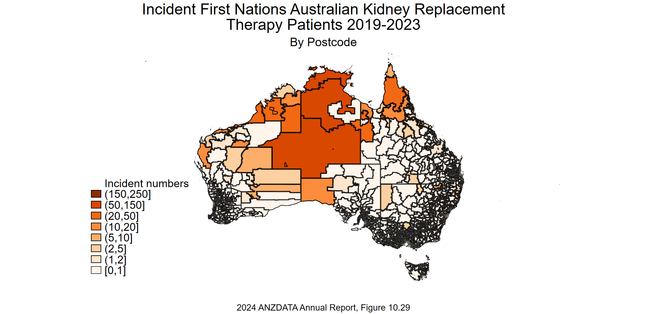

Slide 37
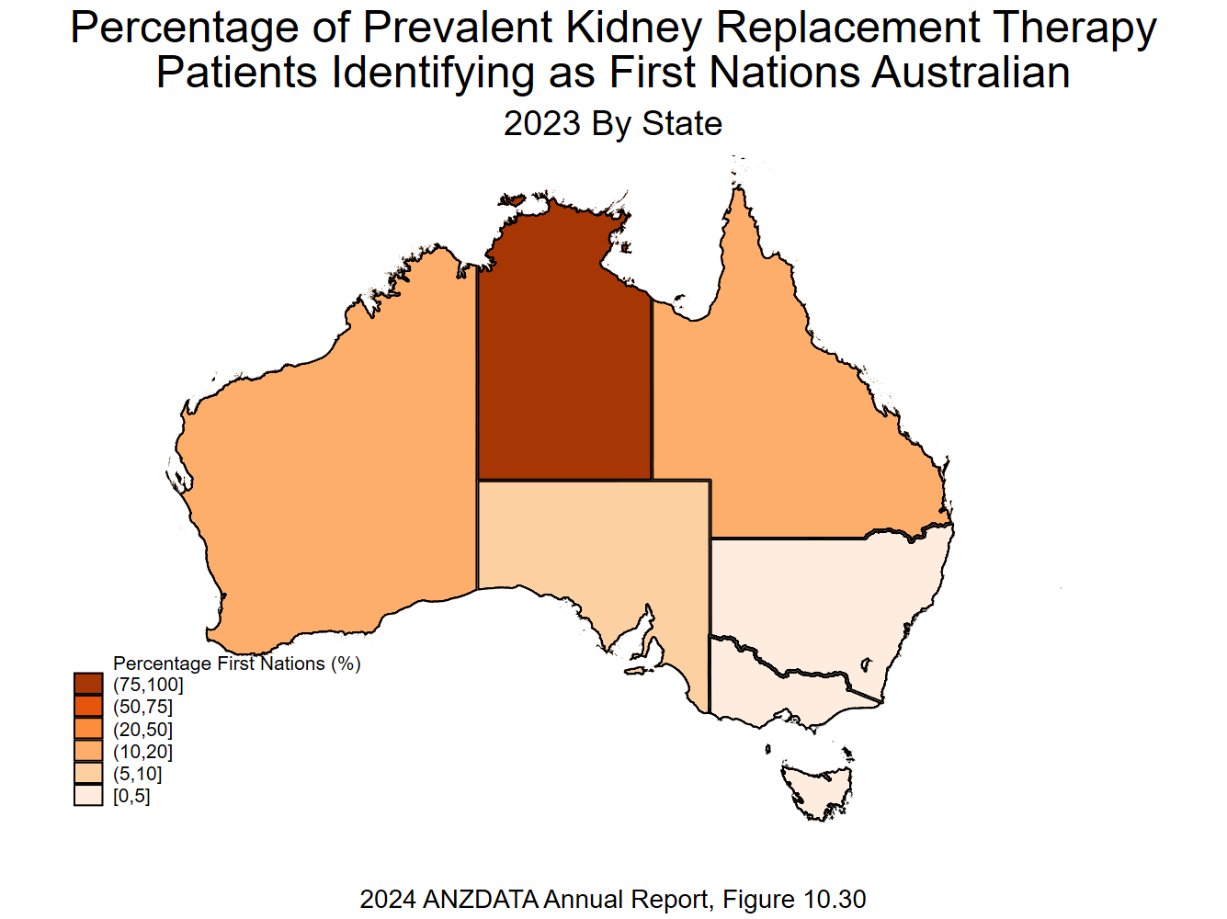

Slide 38
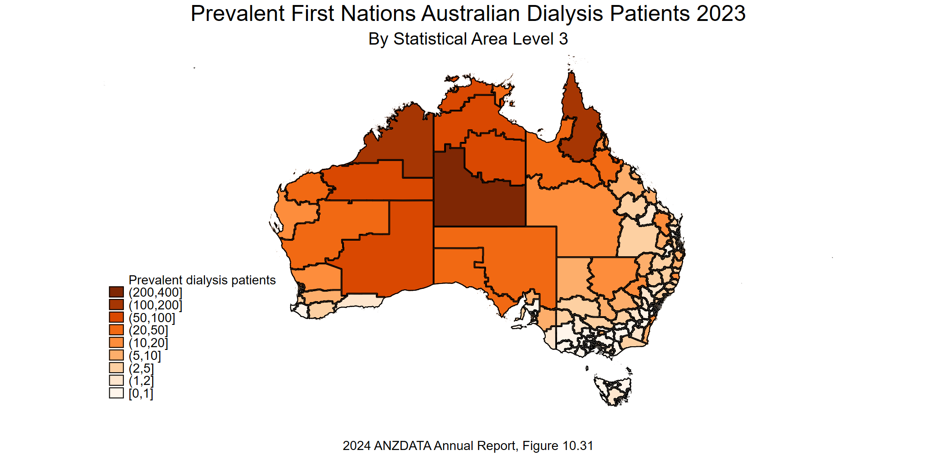

Slide 40
Attribution Statement
ANZDATA encourages utilisation of data presented in these graphs for the benefit of patients and the renal community in Australia and New Zealand, to improve care quality and health
Outcomes. For more information visit https://www.anzdata.org.au/anzdata/publications/attribution-statement/
Publications that incorporate ANZDATA sourced data such as displayed in these graphs, then “ANZDATA Registry” should be acknowledged with the disclaimer below included.
“The data reported here have been supplied by the Australia and New Zealand Dialysis and Transplant Registry (ANZDATA). The interpretation and reporting of these data are the responsibility of the Editors and in no way should be seen as an official policy or interpretation of the Australia and New Zealand Dialysis and Transplant Registry.”

