Slide 1
Section 8 Deceased Donor Lung Donation
Annual Report 2021
(Data analysis to 31-December-2020)

Slide 2
Contents
Figure 8.2.1 Recipients of Lung Transplants by Donor Pathway Australia 1998-2020
Figure 8.2.2 Recipients of Lung Transplants by Donor Pathway New Zealand 1998-2020
Figure 8.3 Deceased Donor Lung Transplant Recipients* by Transplant Region, Australia and New Zealand, 2019-2020
Figure 8.4.1 Age of Donors Providing Retrieved Lungs Australia 2020
Figure 8.4.2 Age of Donors Providing Retrieved Lungs New Zealand 2020
Figure 8.5.1 Non-utilisation Rate of Retrieved Lungs - Australia 2016-2020
Figure 8.5.2 Non-utilisation Rate of Retrieved Lungs - New Zealand 2016-2020
Citation

Slide 3
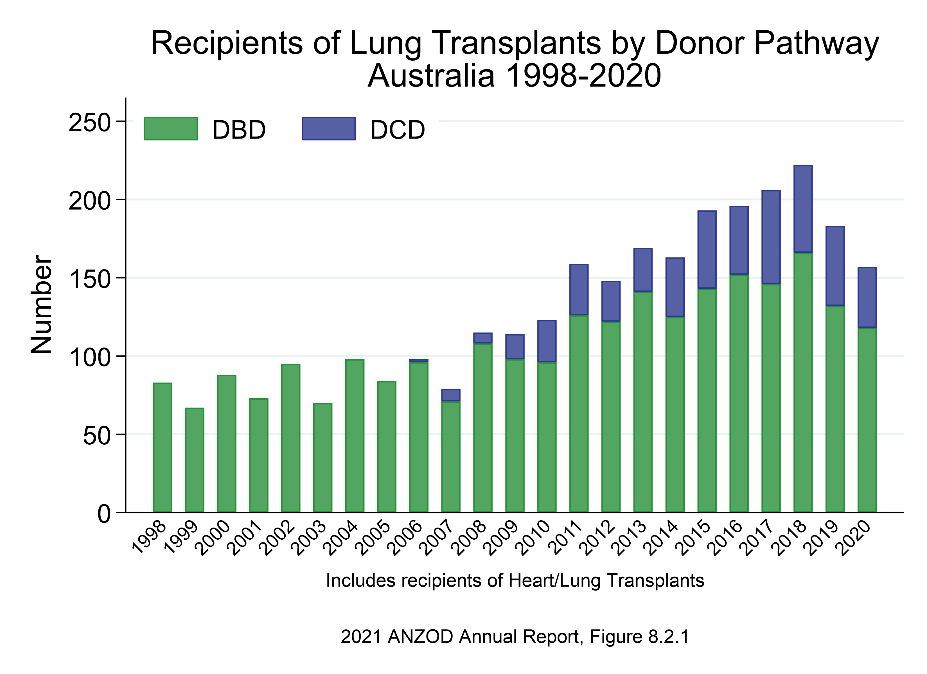

Slide 4
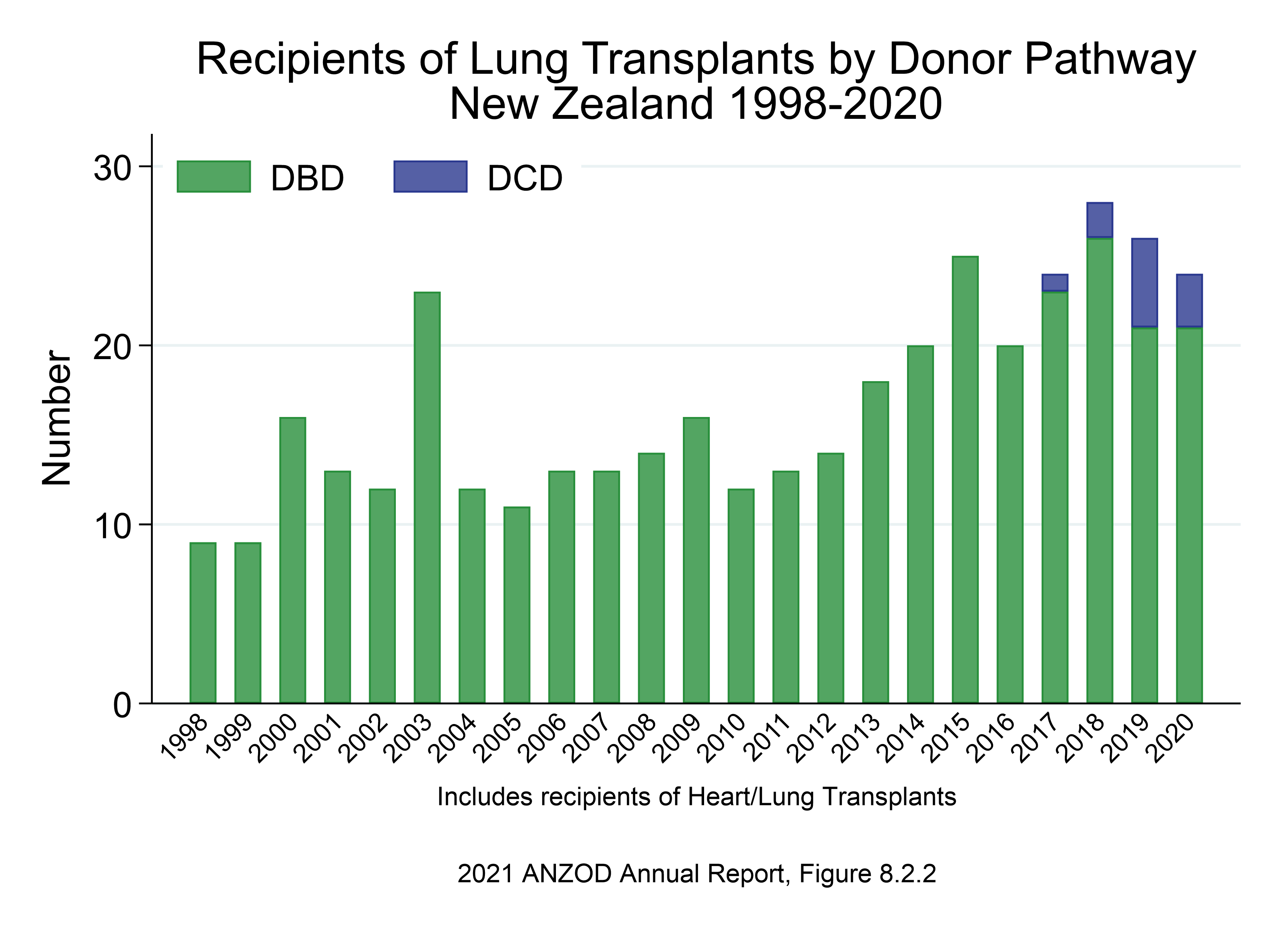

Slide 5
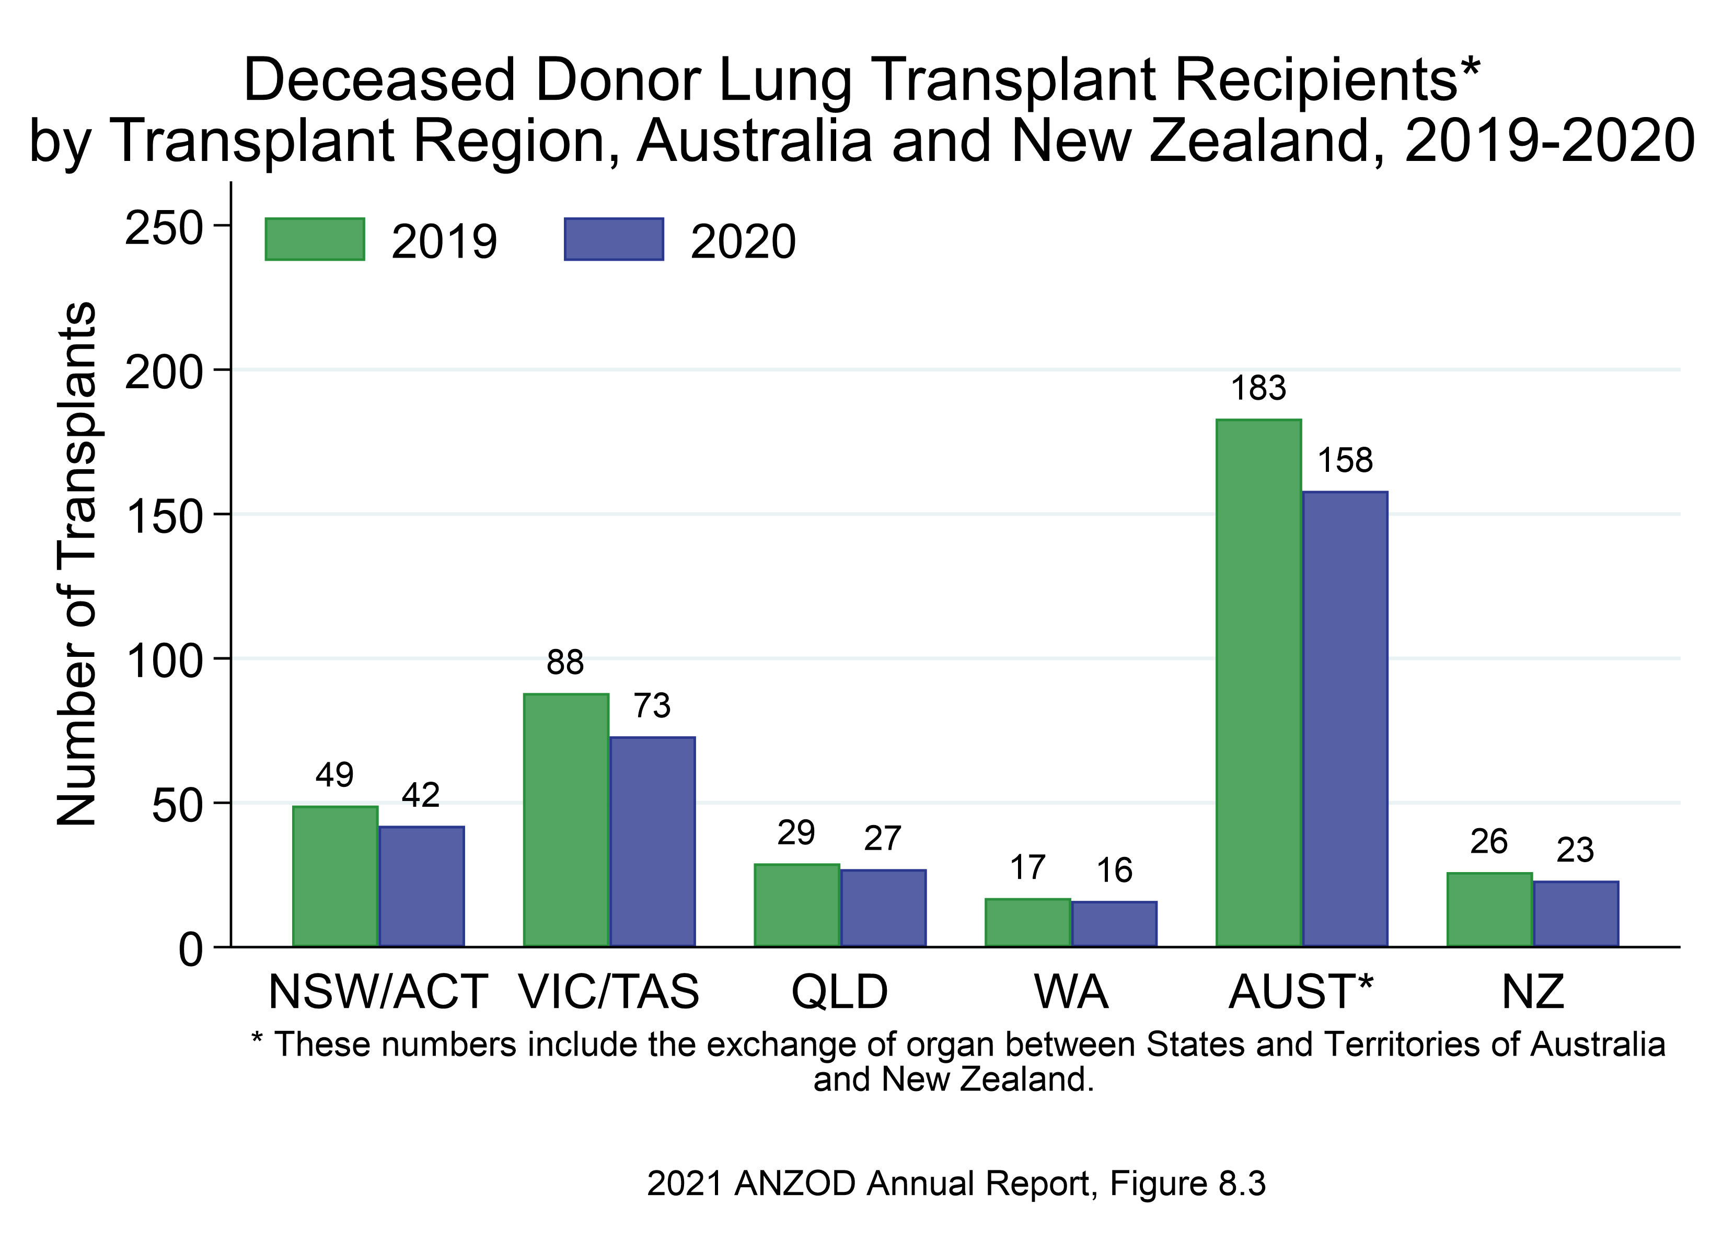

Slide 6
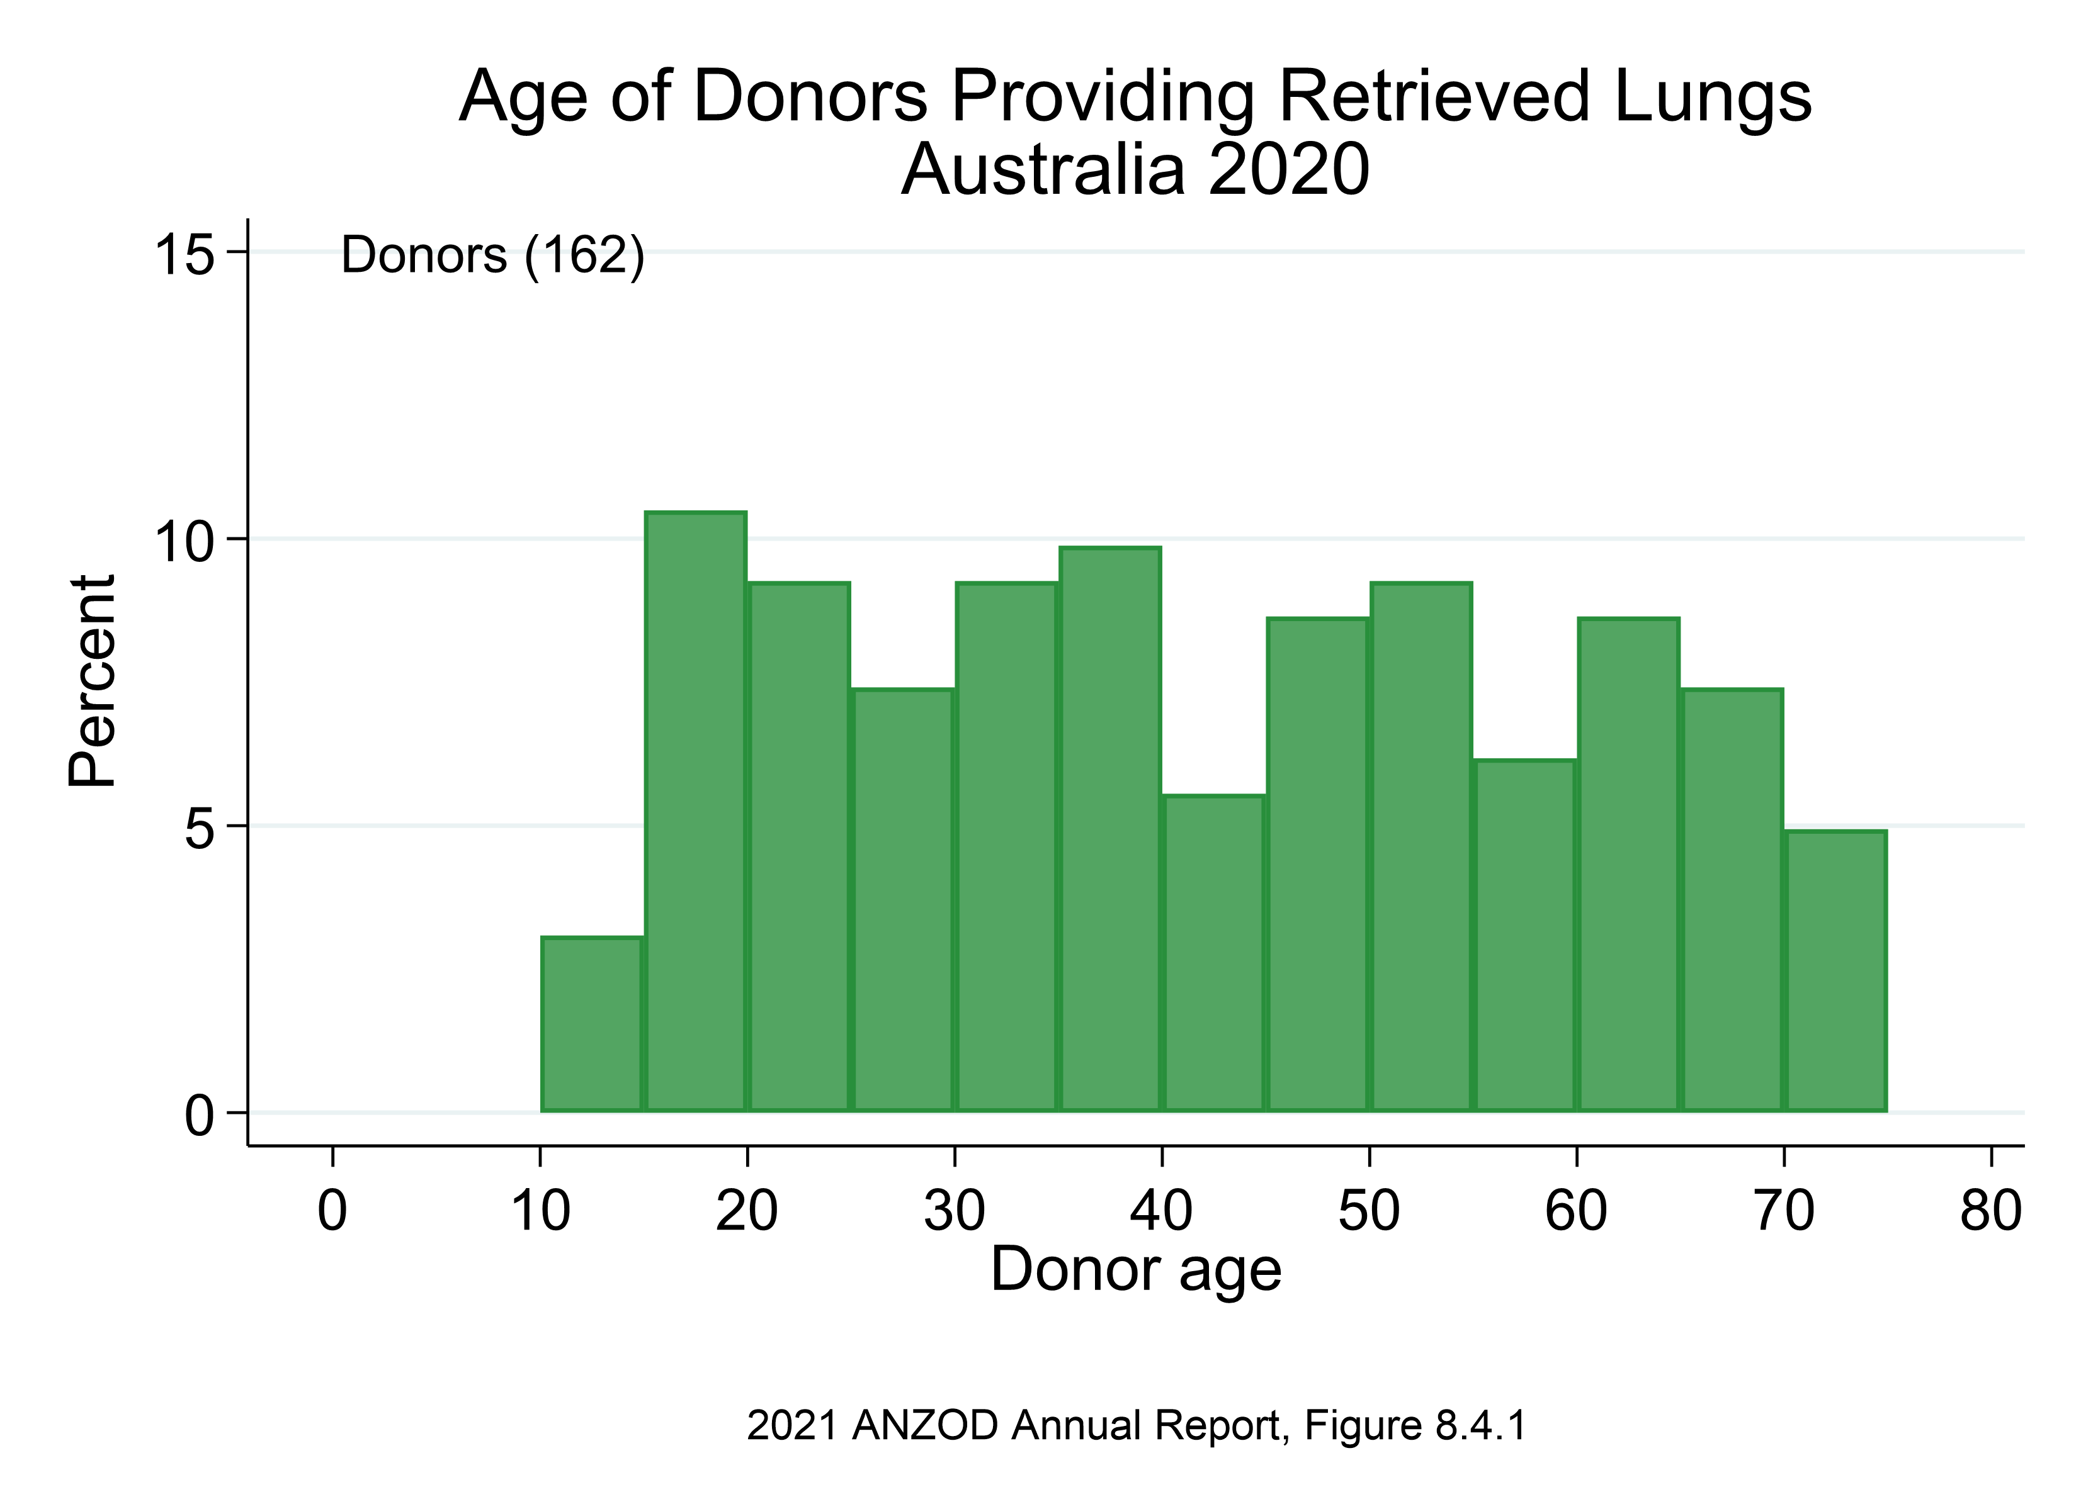

Slide 7
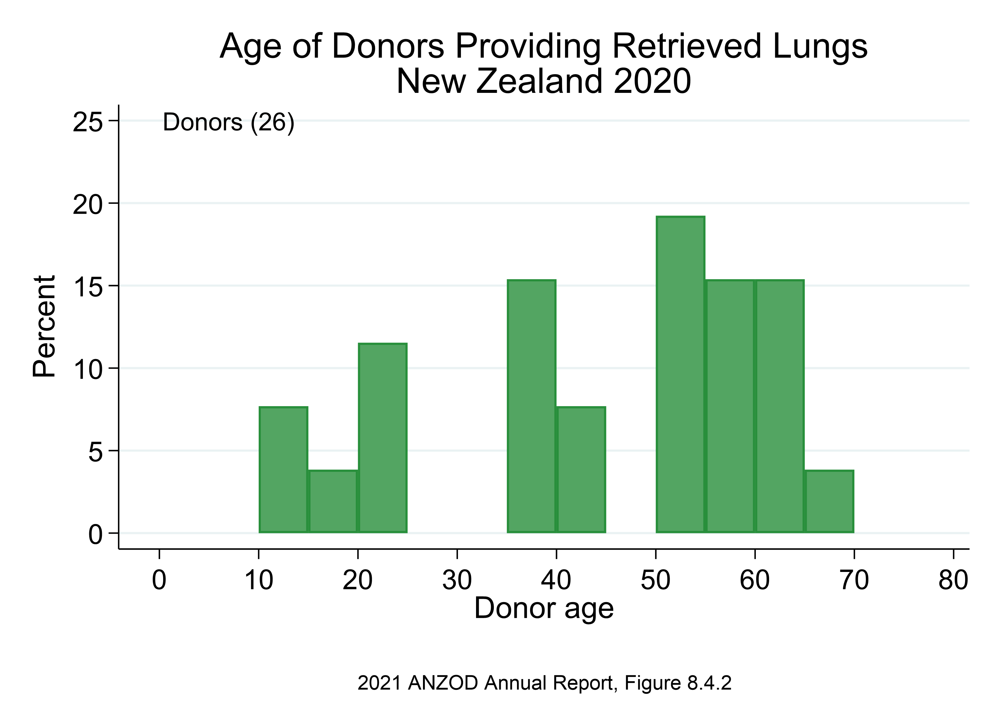

Slide 8
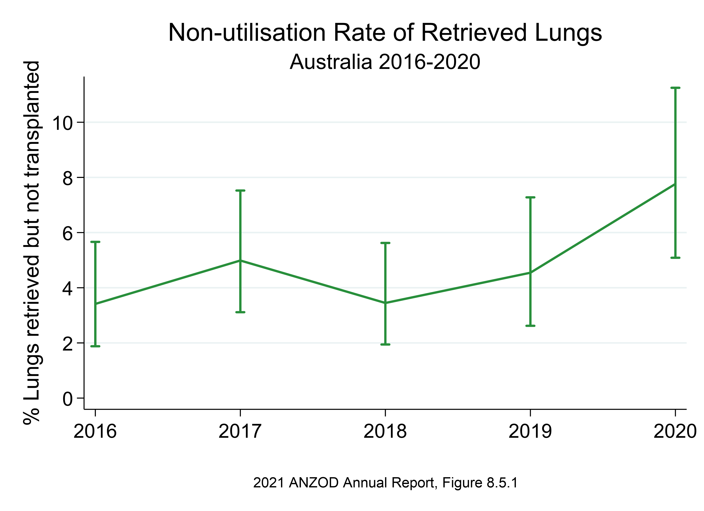

Slide 9
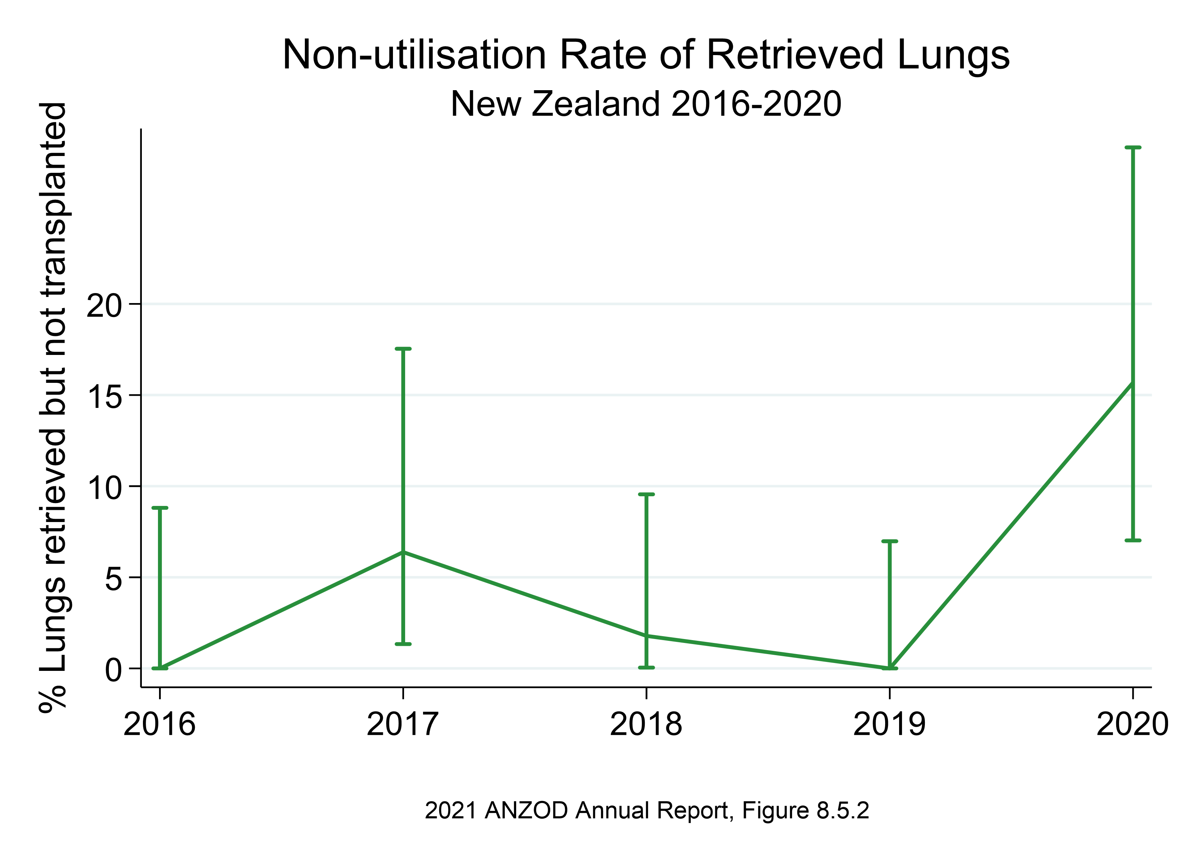

Slide 10
Citation
ANZOD Registry. 2021 Annual Report, Section 8: Deceased Donor Lung Donation. Australia and New Zealand Dialysis and Transplant Registry, Adelaide, Australia. 2020. Available at: https://www.anzdata.org.au/report/anzod-annual-report-2021/

