Slide 1
Section 4 Deceased Organ Donation Profile
Annual Report 2021
(Data analysis to 31-December-2020)

Slide 2
Contents
Figure 4.1.1 Age and Gender of Deceased Donors Australia 2012-2020
Figure 4.1.2 Age and Gender of Deceased Donors New Zealand 2012-2020
Figure 4.2.1 Age of Male and Female Donors 2012-2020 Australia
Figure 4.2.2 Age of Male and Female Donors 2012-2020 New Zealand

Slide 3
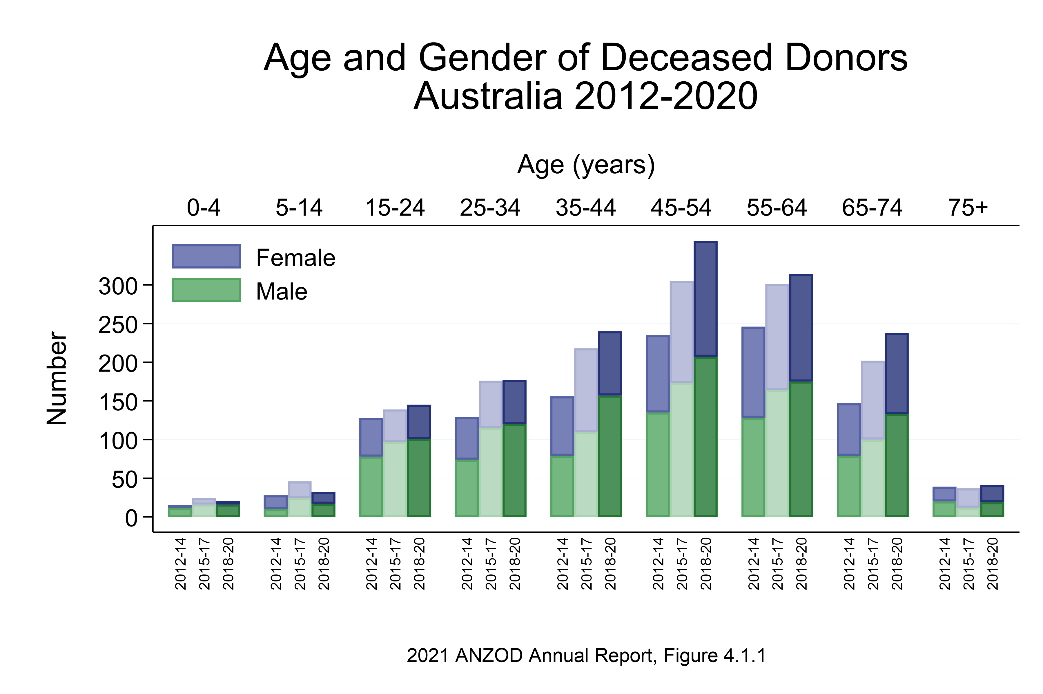

Slide 4
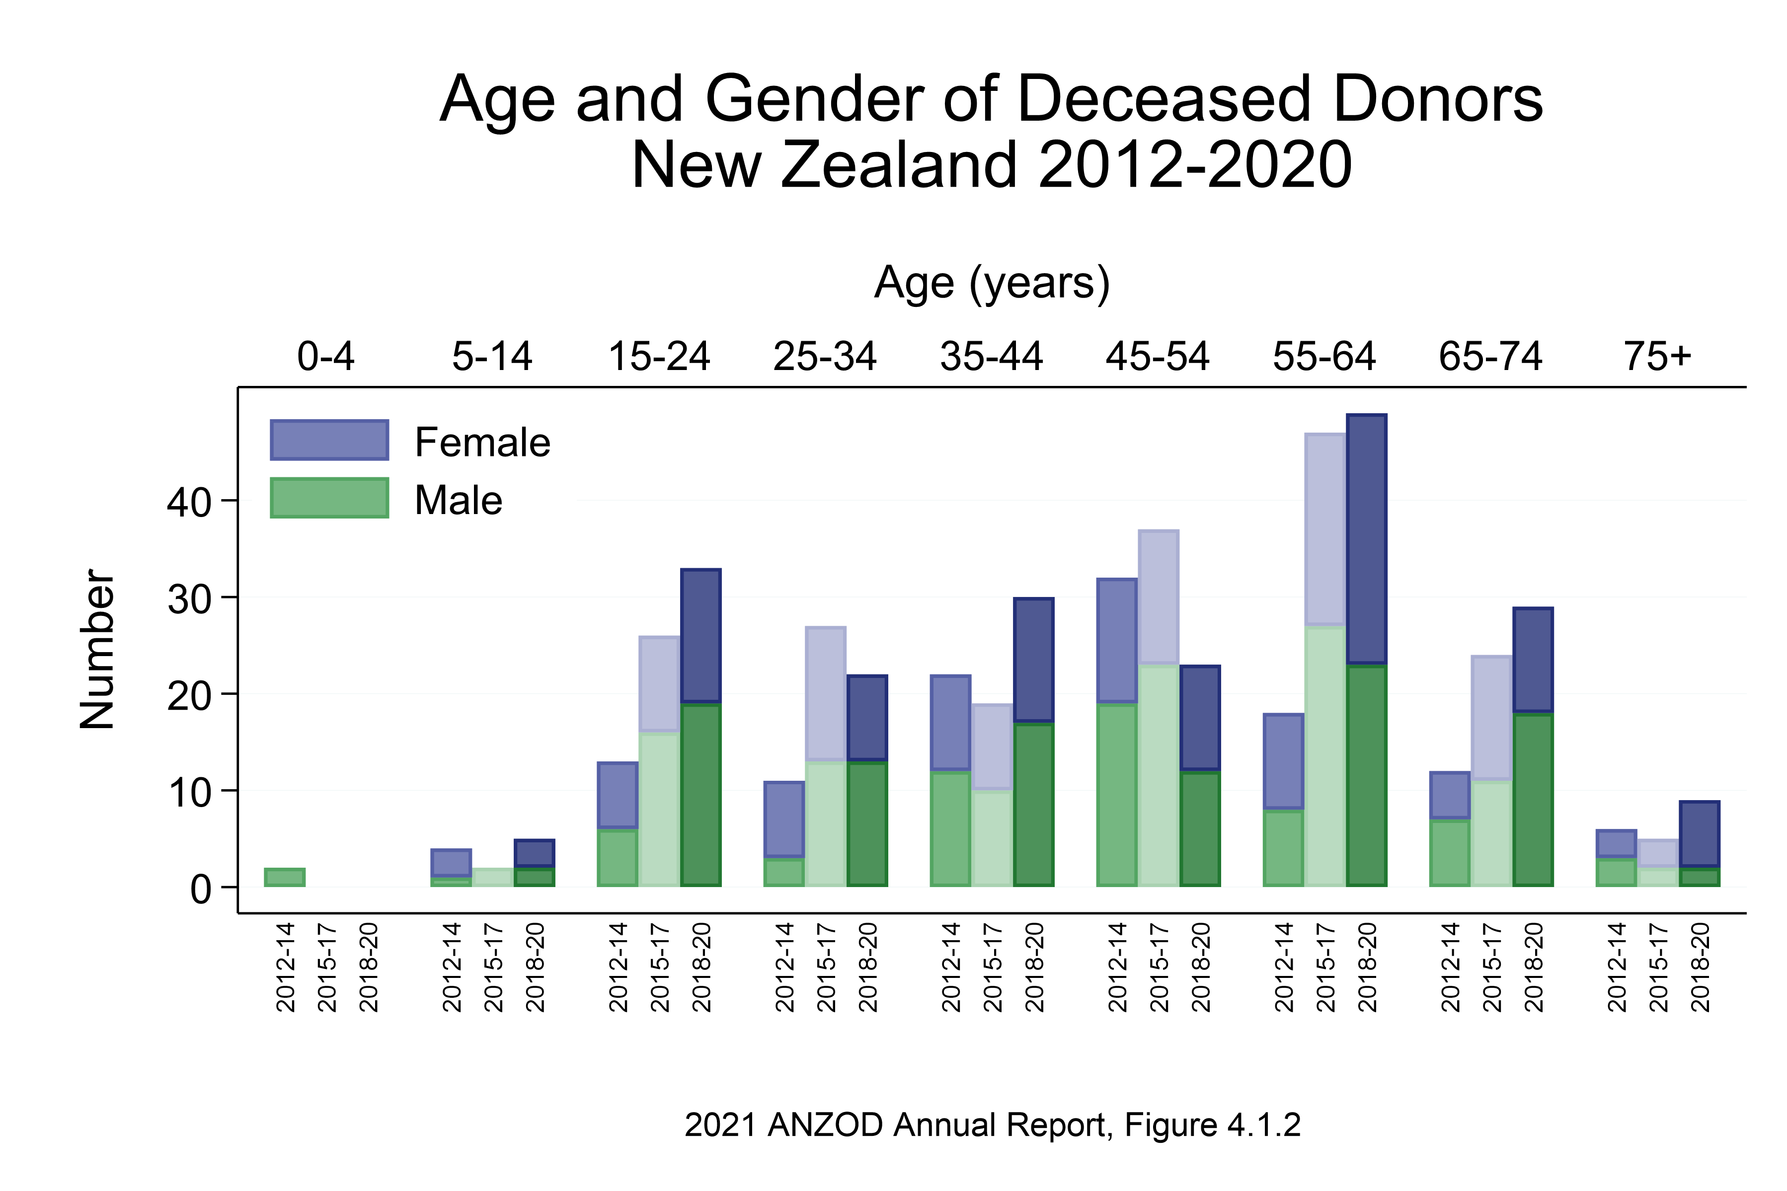

Slide 5
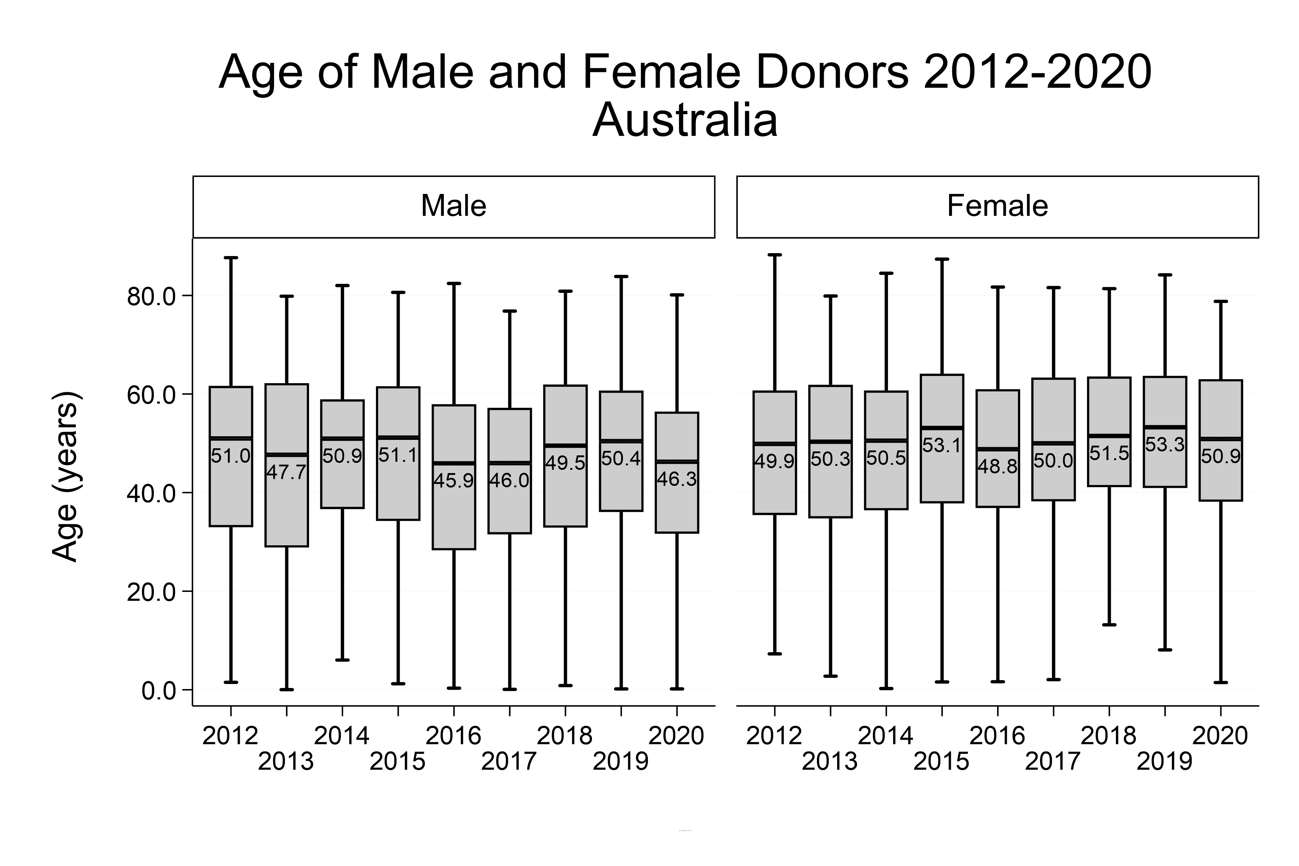
2021 ANZOD Annual Report, Figure 4.2.1

Slide 6
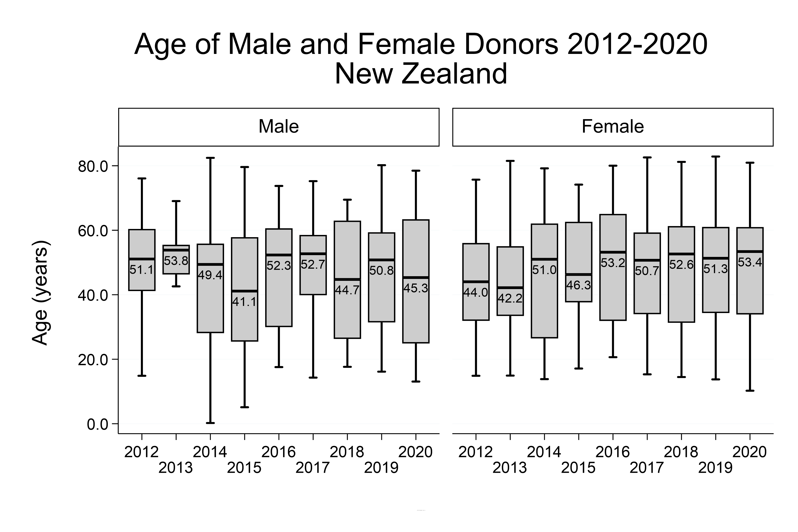
2021 ANZOD Annual Report, Figure 4.2.2

Slide 7
Citation
ANZOD Registry. 2021 Annual Report, Section 4: Deceased Organ Donor Profile. Australia and New Zealand Dialysis and Transplant Registry, Adelaide, Australia. 2021. Available at: https://www.anzdata.org.au/report/anzod-annual-report-2021/

