Slide 1
Section 3 Deceased Organ Donation Pathway
Annual Report 2021
(Data analysis to 31-December-2020)

Slide 2
Contents
Figure 3.1.1 Time from Admission to Brain Death (hours) DBD Donors - Australia 2016-2020
Figure 3.1.2 Time from Admission to Brain Death (hours) DBD Donors - New Zealand 2016-2020
Figure 3.2 Time from Admission to Circulatory Death (hours) DCD Donors - Australia 2016-2020
Figure 3.3.1 Time from Ventilation to Brain Death (hours) DBD Donors - Australia 2016-2020
Figure 3.3.2 Time from Ventilation to Brain Death (hours) DBD Donors - New Zealand 2016-2020
Figure 3.4 Time from Ventilation to Circulatory Death (hours) DCD Donors - Australia 2016-2020
Figure 3.5.1 Time from Brain Death to Donation (hours) DBD Donors - Australia 2016-2020
Figure 3.5.2 Time from Brain Death to Donation (hours) DBD Donors - New Zealand 2016-2020
Figure 3.6 Time from Circulatory Death to Donation (minutes) DCD Donors - Australia 2016-2020
Citation

Slide 3
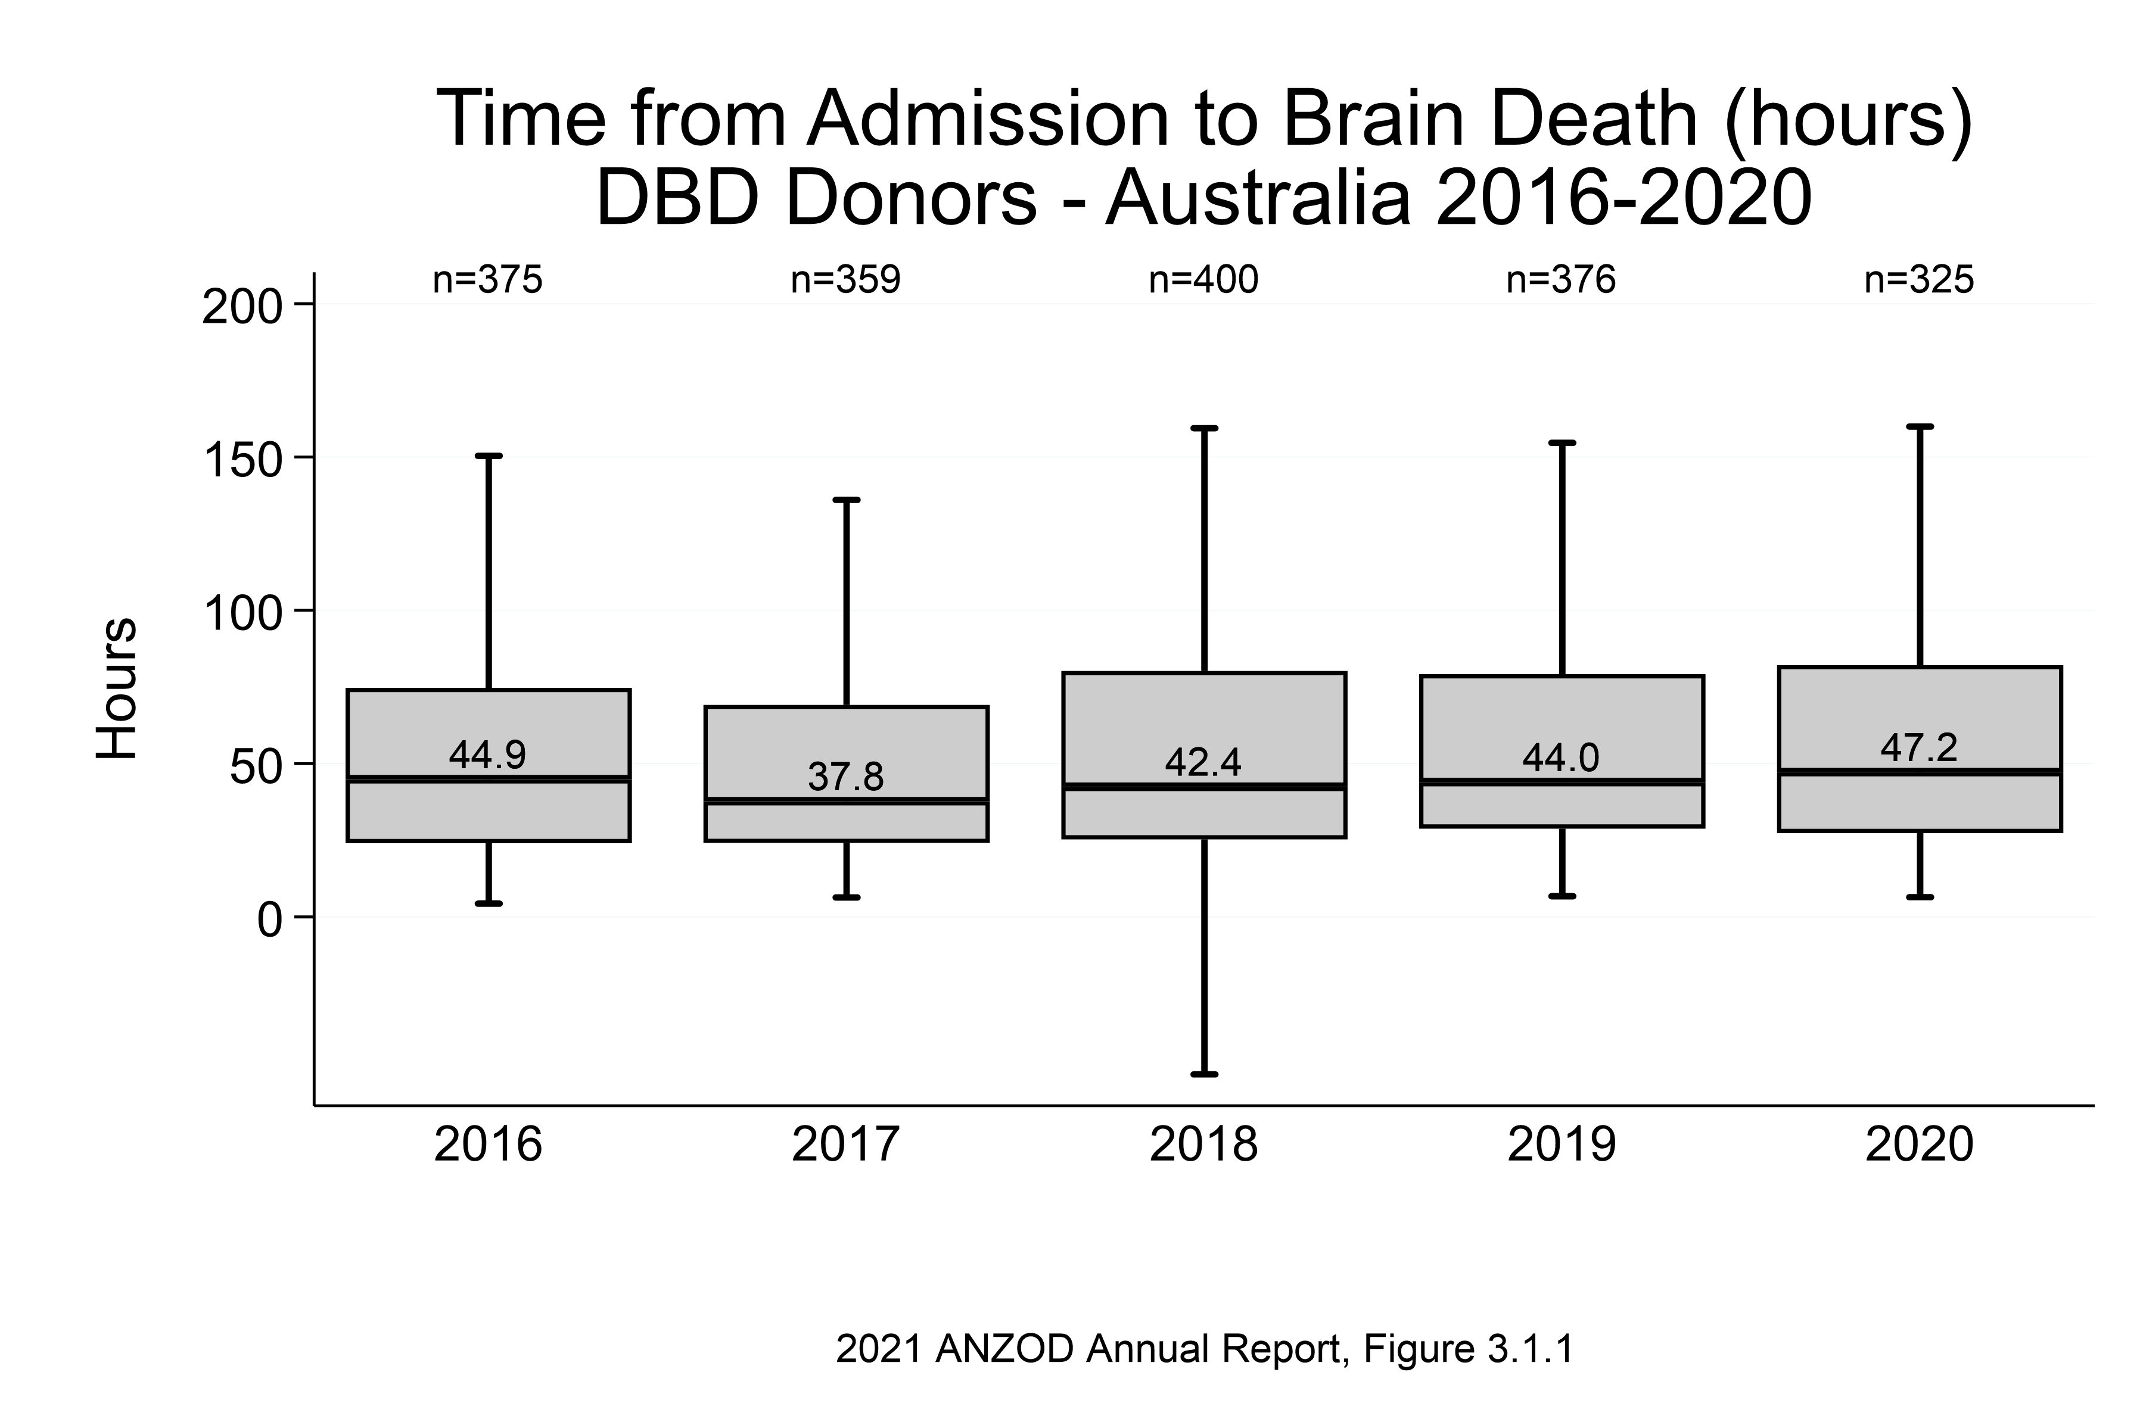

Slide 4
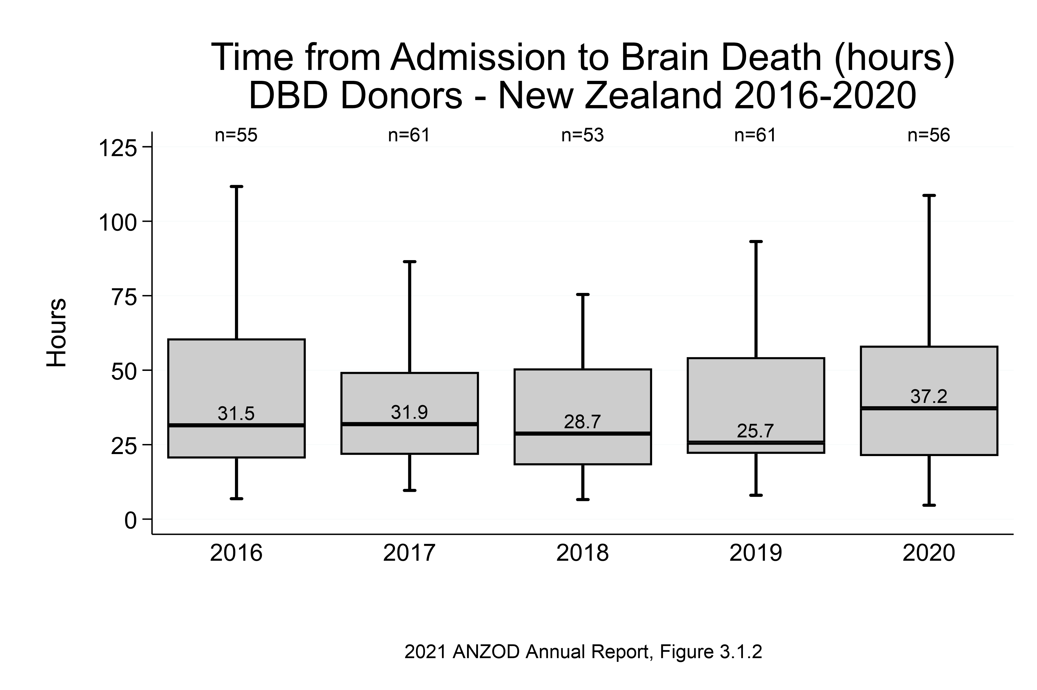

Slide 5
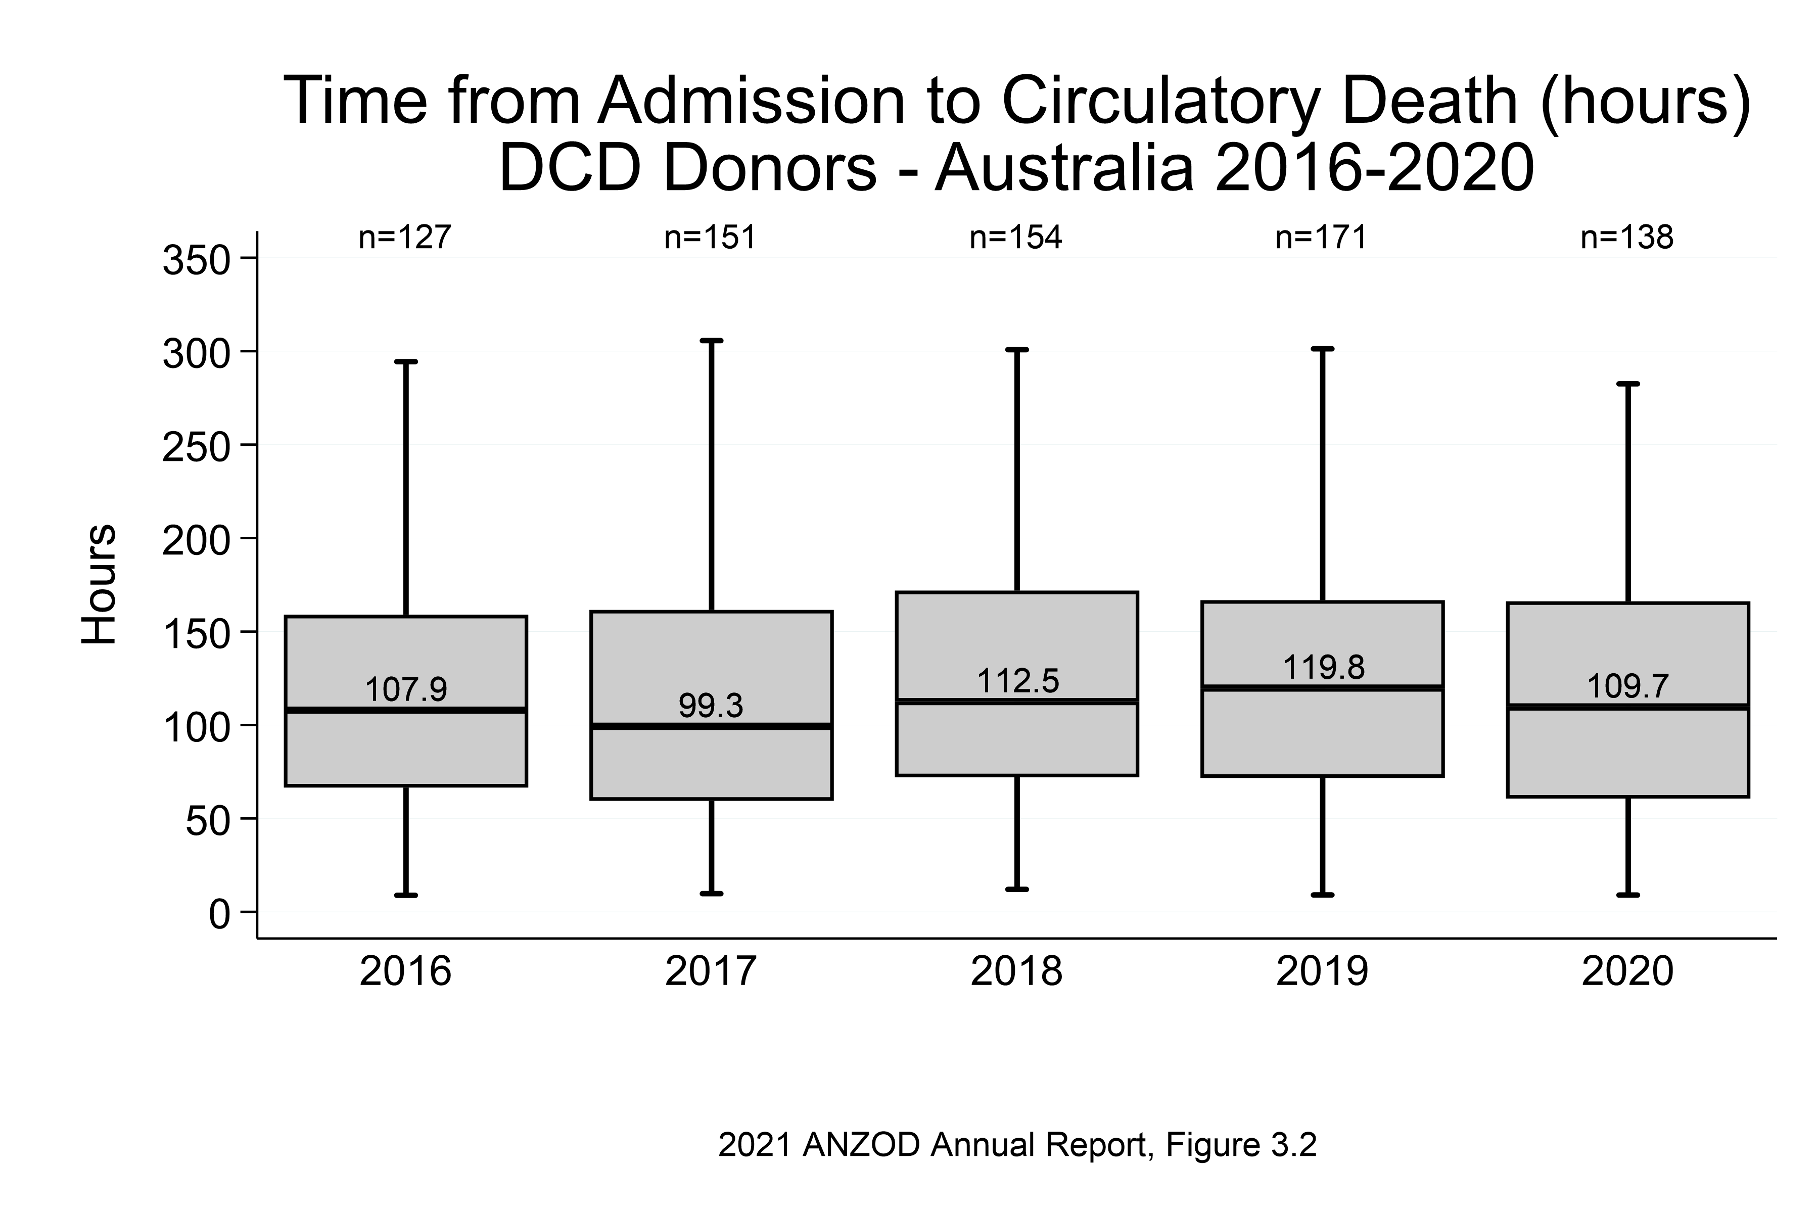

Slide 6
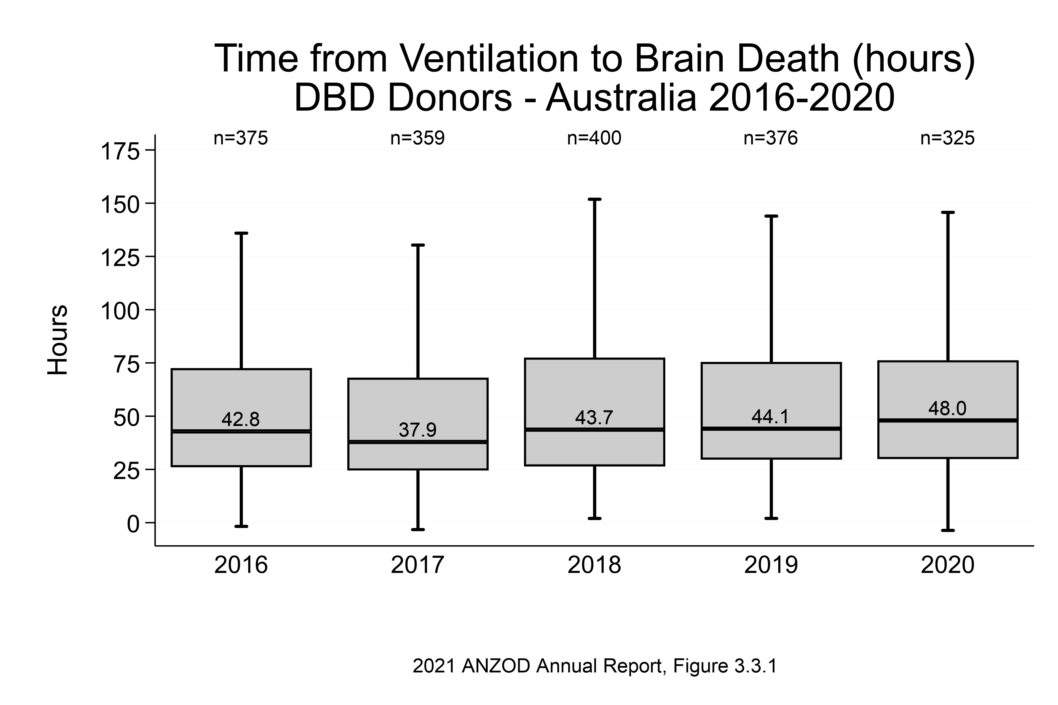

Slide 7
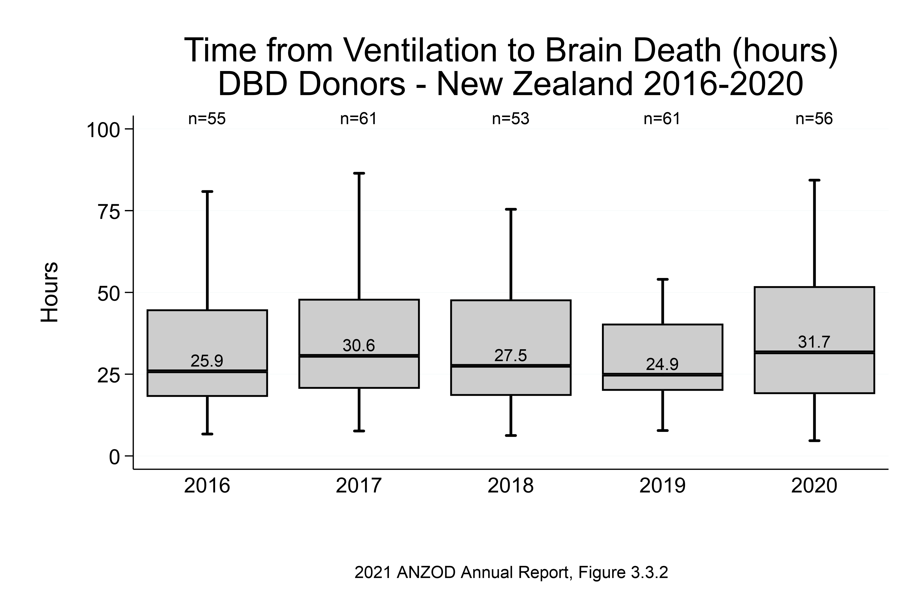

Slide 8
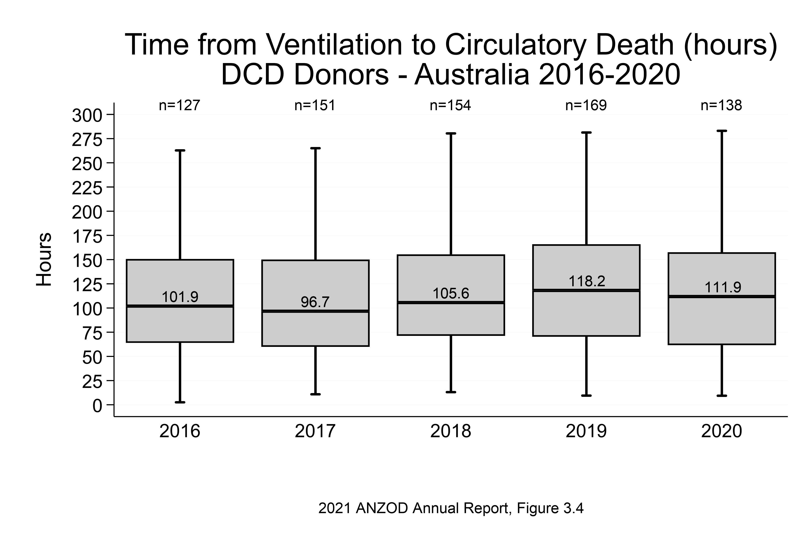

Slide 9
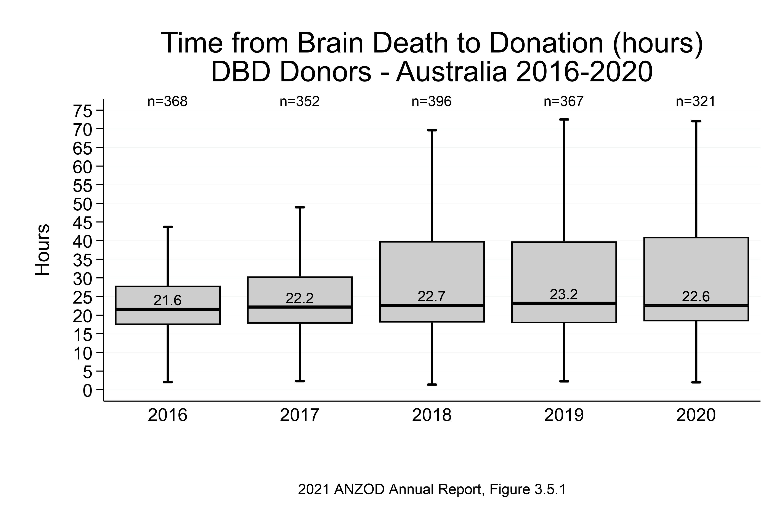

Slide 10
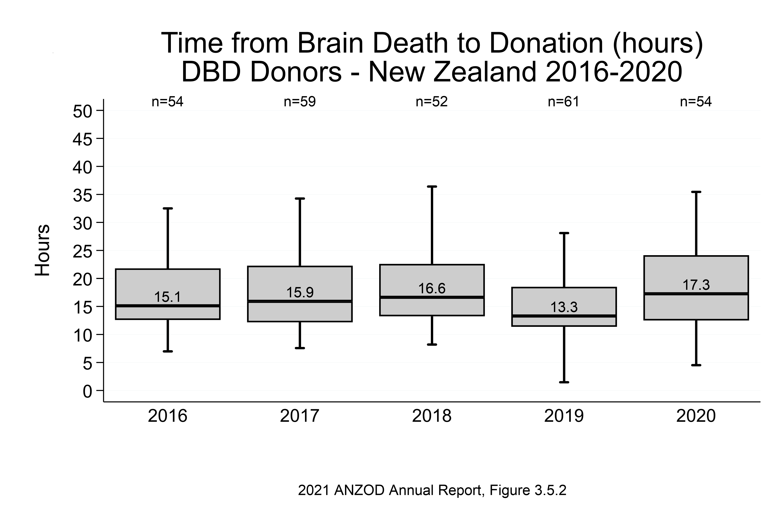

Slide 11
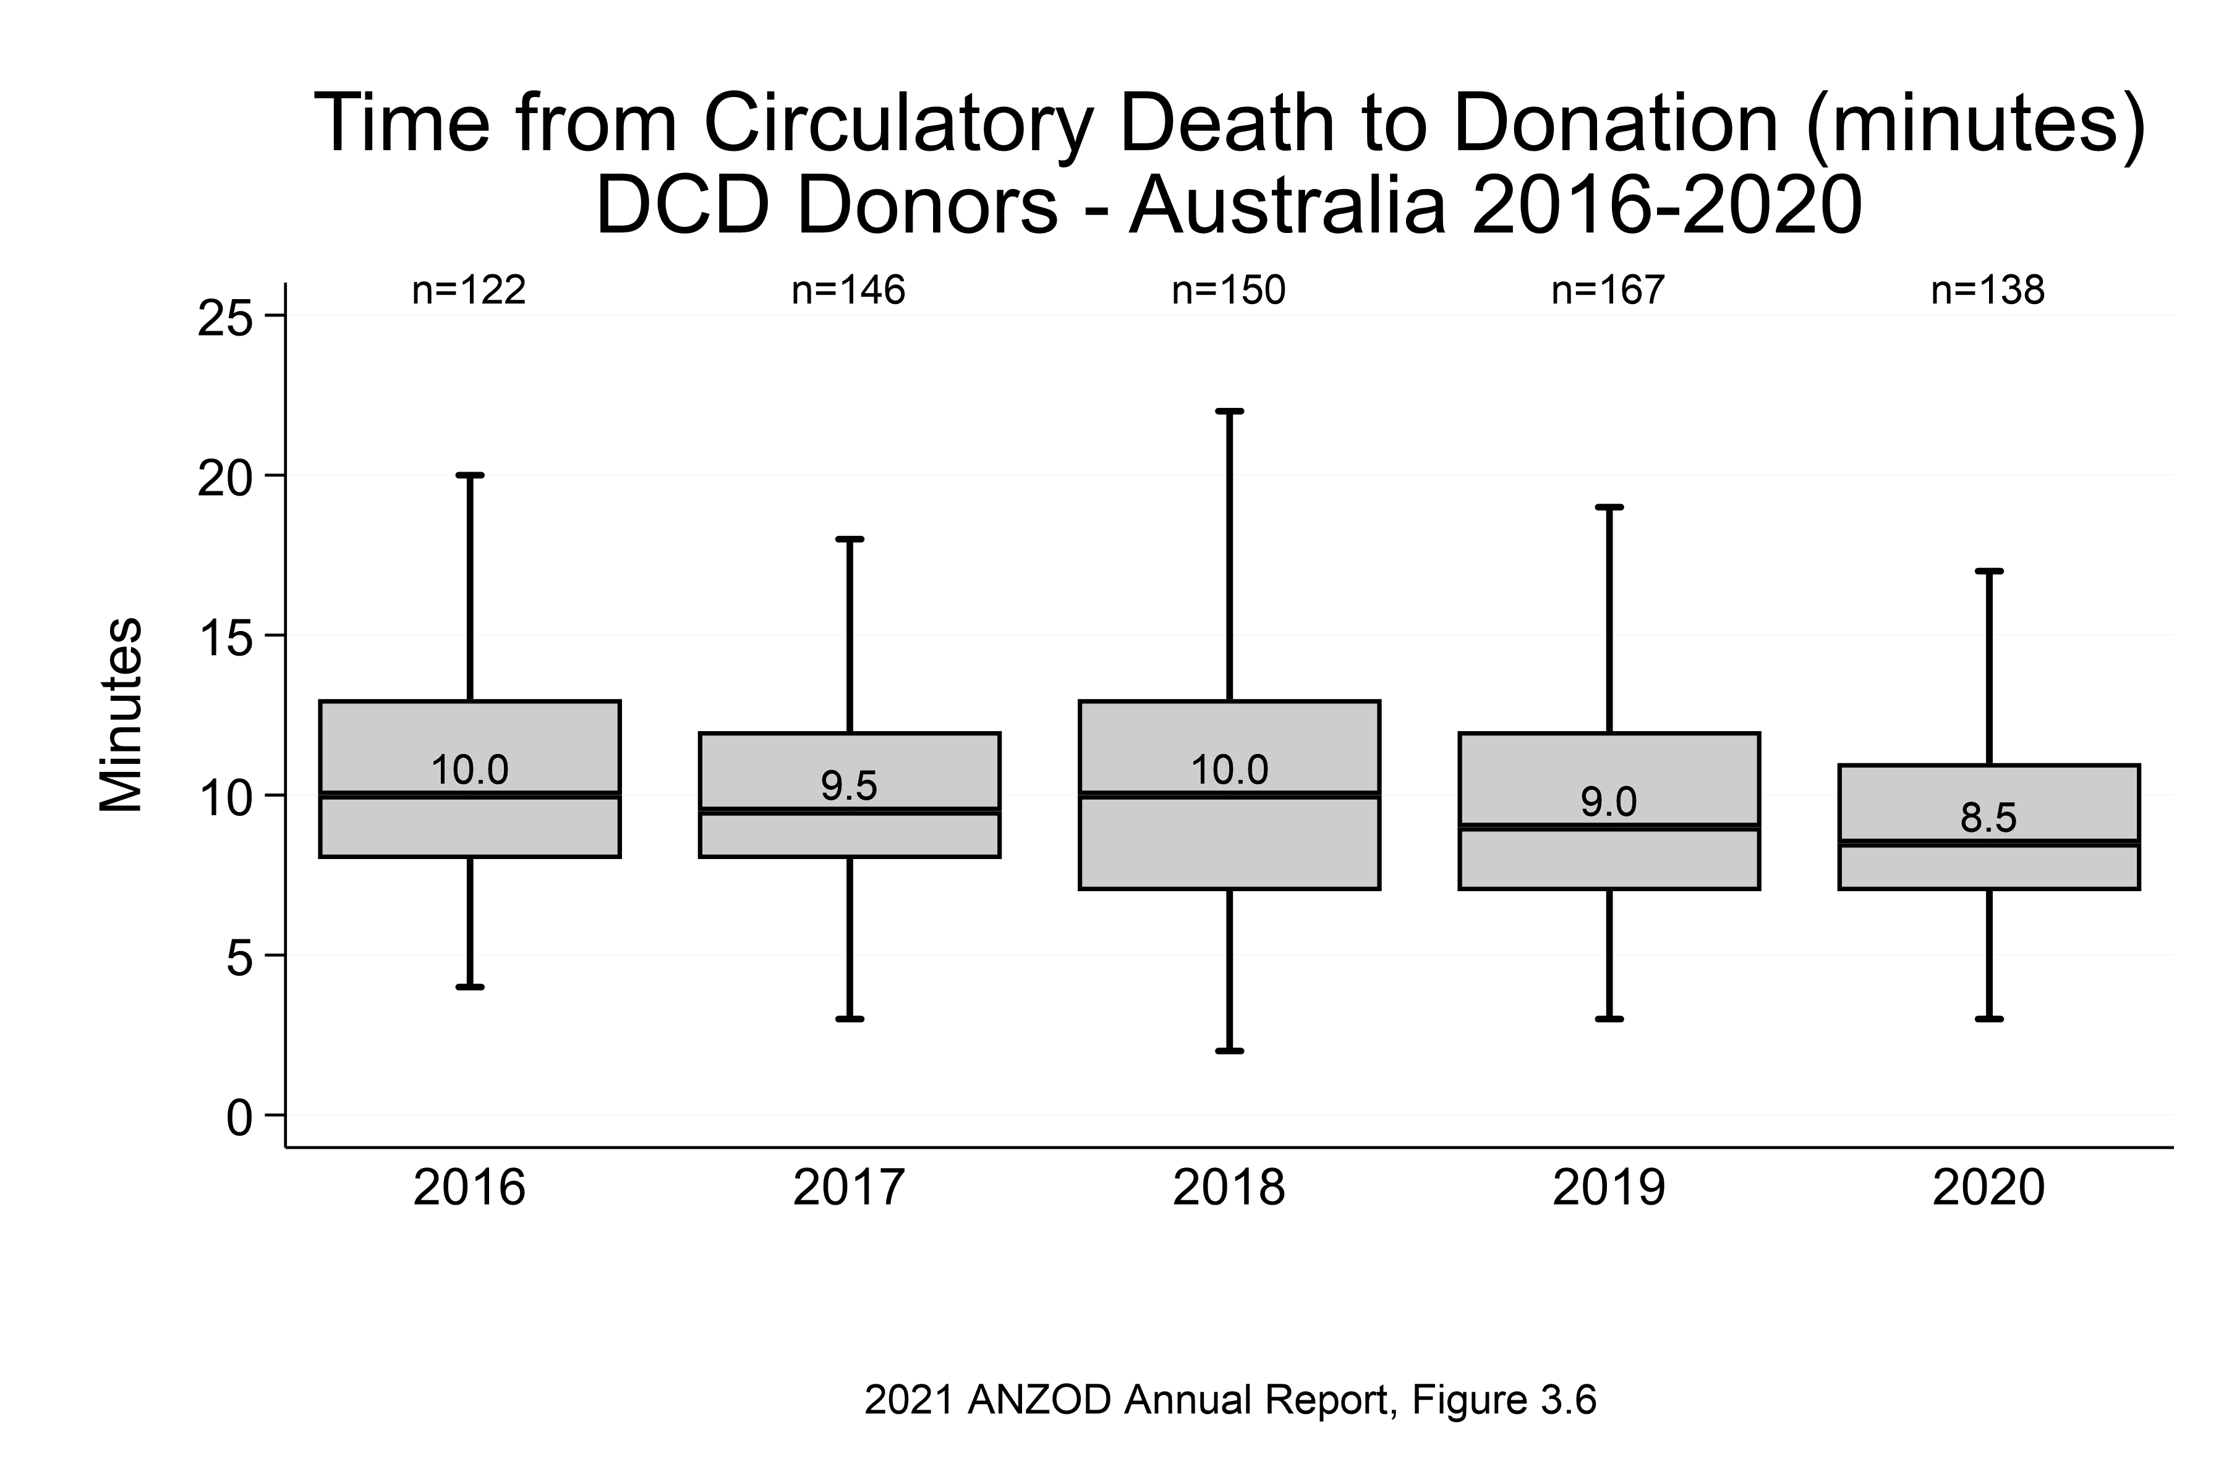

Slide 12
Citation
ANZOD Registry. 2021 Annual Report, Section 3: Deceased Organ Donor Pathway. Australia and New Zealand Dialysis and Transplant Registry, Adelaide, Australia. 2021. Available at: https://www.anzdata.org.au/report/anzod-annual-report-2021/

