Slide 1
End Stage Kidney Disease in Aboriginal and Torres Strait Islander Australians
ANZDATA Registry 43rd Annual Report
Data to 31-Dec-2019
Chapter 10 - Graphs

Slide 2

List
of Figures
Figure 10.1 Percentage of New Patients Commencing on Haemodialysis – Australia
Figure 10.2 Unadjusted Incident RRT Rate – Australia
Figure 10.3 Relative Incidence Rate of Treated ESKD for Indigenous Patients by Gender (Comparison to Non-Indigenous Australians) - 2015-2019
Figure 10.4 Age-specific Incidence Rates of Treated ESKD - Among Indigenous Australians, by State and Age at RRT start 2015-2019
Figure 10.5.1 Age-specific Incidence Rates of Treated ESKD - Non-Indigenous, Australia
Figure 10.5.2 Age-specific Incidence Rates of Treated ESKD - Indigenous, Australia
Figure 10.6.1 Prevalent Patients by Modality - Australia - Indigenous
Figure 10.6.2 Prevalent Patients by Modality - Australia - Non-Indigenous
Figure 10.7 Prevalent Haemodialysis at Home by Ethnicity – Australia
Figure 10.8 Donor Type by Ethnicity - Australia 2010-2019
Figure 10.9 Donor Type by Ethnicity and Year - Australia

Slide 3
Figure 10.9 Donor Type by Ethnicity and Year - Australia
Figure 10.10 Percentage of Patients Starting RRT with Pre-emptive Kidney Transplant - Australia
Figure 10.11 Patient Survival, Recipients of Primary DD Transplants - Australia 2010-2019
Figure 10.12 Graft Survival, Recipients of Primary DD Transplants - Australia 2010-2019
Figure 10.13 Transplant Outcomes - Primary Deceased Donor Kidney-only Transplants Australia 2010-2019
Figure 10.14 Dialysis Modality End 2019 - Australia, by Ethnicity
Figure 10.15 Incident Dialysis Patient Survival 2010-2019 - Australia
Figure 10.16 eGFR at Dialysis Initiation - Australia
Figure 10.17 Incidence of New Indigenous Australian Patients
Figure 10.18 Incidence of New Transplants Indigenous Australian Patients - By referring state
Figure 10.19 Median Time to Primary Transplant Indigenous Australian Patients - By referring state, Transplants during 2012-2015 vs 2016-2019
List
of Figures
continued

Slide 4
List
of Figures
continued
Figure 10.20 Prevalent Indigenous Australian Haemodialysis Patients
Figure 10.21 Prevalent Indigenous Australian Peritoneal Dialysis Patients
Figure 10.22 Prevalent Indigenous Australian Transplant Patients
Figure 10.23 Deaths of Indigenous Australian RRT patients
Figure 10.24 Incident Indigenous Australian Renal Replacement Therapy Patients 2015-2019 - By Postcode
Figure 10.25 Percentage of Prevalent Renal Replacement Therapy Patients Identifying as Indigenous Australian - 2019 By State
Figure 10.26 Prevalent Indigenous Australian Dialysis Patients 2019 - By Statistical Area Level 3
Figure 10.27 Cause of Death by Modality and Ethnicity, Australia - Deaths Occurring During 2019

Slide 30
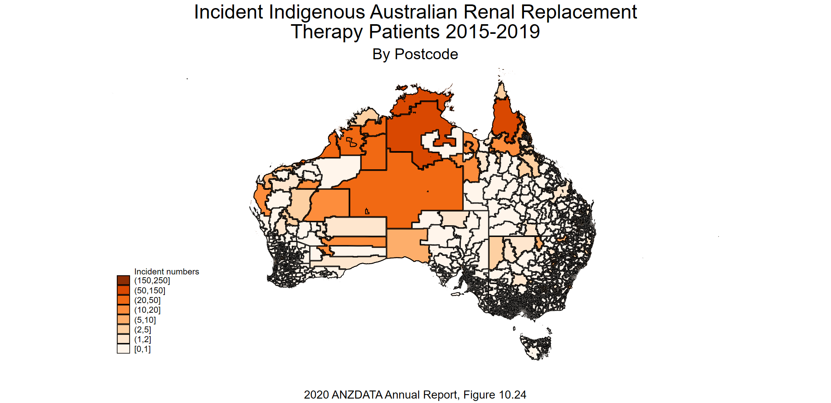

Slide 31
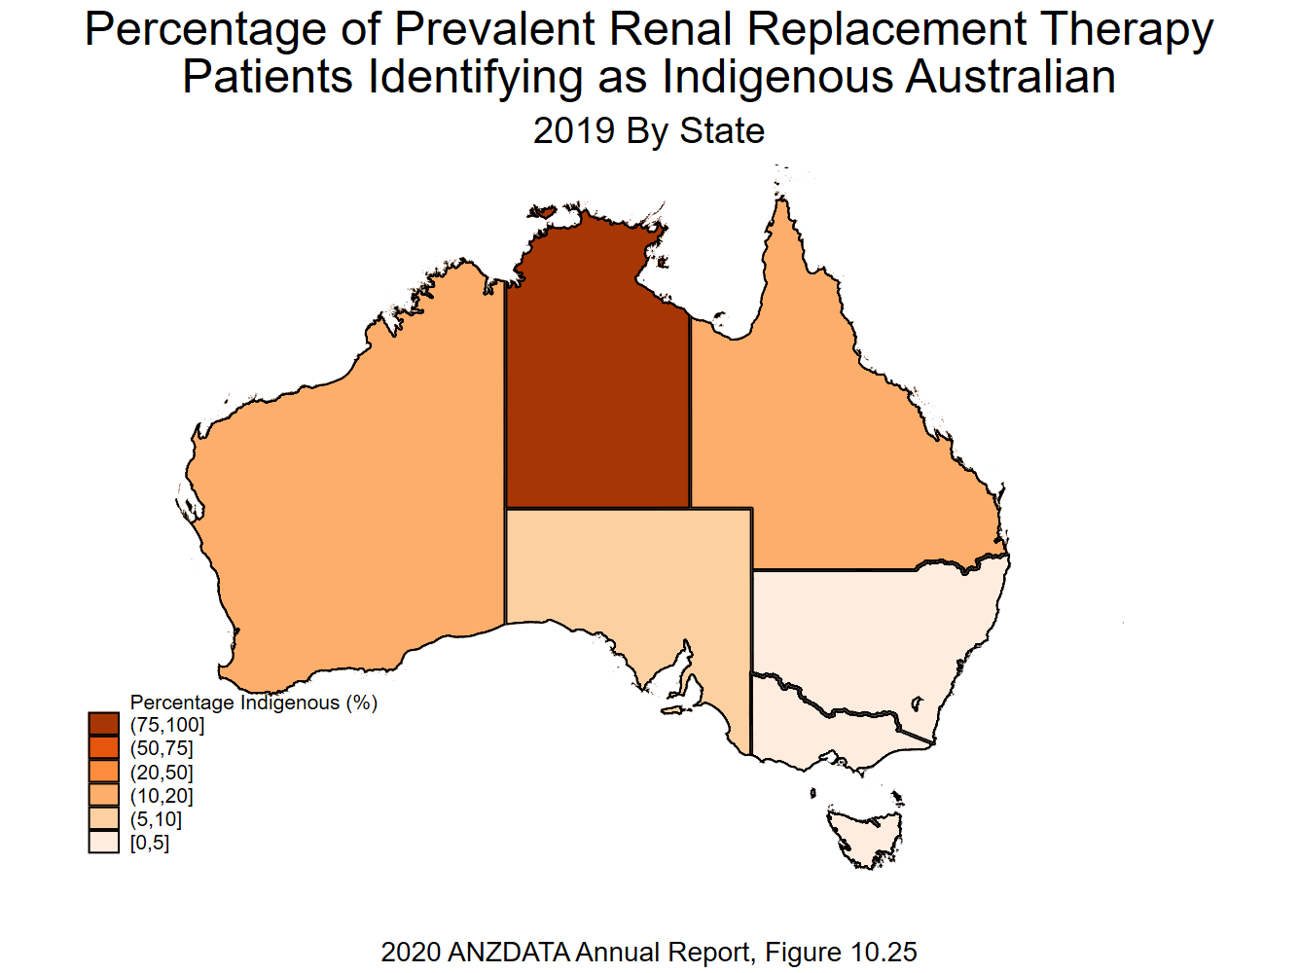

Slide 32
