Slide 1
End Stage Kidney Disease in Aboriginal and Torres Strait Islander Australians
ANZDATA Registry 42st Annual Report
Data to 31-Dec-2018
Chapter 10 - Graphs

Slide 2

Figure 10.1 Percentage of New Patients Commencing on Haemodialysis - Australia
Figure 10.2 Unadjusted Incident RRT Rate - Australia
Figure 10.3 Relative Incidence Rate of Treated ESKD for Indigenous Patients by Gender - Australia 2014-2018
Figure 10.4 Age-specific Incidence Rates of Treated ESKD - Among Indigenous Australians, by State and Age at RRT start 2014-2018
Figure 10.5.1 Age-specific Incidence Rates of Treated ESKD - Non-indigenous, Australia
Figure 10.5.2 Age-specific Incidence Rates of Treated ESKD - Indigenous, Australia
Figure 10.6.1 Prevalent Patients by Modality - Australia - Indigenous
Figure 10.6.2 Prevalent Patients by Modality - Australia - Non-indigenous
Figure 10.7 Prevalent Haemodialysis at Home by Ethnicity - Australia
Figure 10.8 Donor Type by Ethnicity - Australia 2009-2018
Figure 10.9 Donor Type by Ethnicity and Year - Australia
Figure 10.10 Percentage of Patients Starting RRT with Pre-emptive Kidney Transplant - Australia
Figure 10.11 Primary DD Graft Patient Survival 2009-2018 - Australia
Figure 10.12 Primary DD Overall Graft Survival 2009-2018 - Australia
Figure 10.13 Transplant Outcomes, Australia - Primary Deceased Donor Kidney-only Transplants 2009-2018
List
of Figures

Slide 3
List
of Figures
continued
Figure 10.14 Dialysis Modality End 2018 - Australia, by Ethnicity
Figure 10.15 Incident Dialysis Patient Survival 2009-2018 - Australia
Figure 10.16 eGFR at RRT start - Australia
Figure 10.17 Incidence of New Indigenous Australian Patients
Figure 10.18 Incidence of New Transplants Indigenous Australian Patients - By referring state
Figure 10.19 Median Time to Primary Transplant Indigenous Australian Patients - By referring state, Transplants during 2011-2014 vs 2015-2018
Figure 10.20 Prevalent Indigenous Australian Haemodialysis Patients
Figure 10.21 Prevalent Indigenous Australian Peritoneal Dialysis Patients
Figure 10.22 Prevalent Indigenous Australian Transplant Patients
Figure 10.23 Deaths of Indigenous Australian RRT patients
Figure 10.24 Incident Indigenous Australian Patients 2014-2018 - By Postcode
Figure 10.25 Prevalent Indigenous Australian Patients 2018 - By State
Figure 10.26 Prevalent Indigenous Australian Dialysis Patients 2018 - By Statistical Area Level 3
Figure 10.27 Cause of Death by Modality and Ethnicity, Australia - Deaths Occurring During 2018

Slide 29
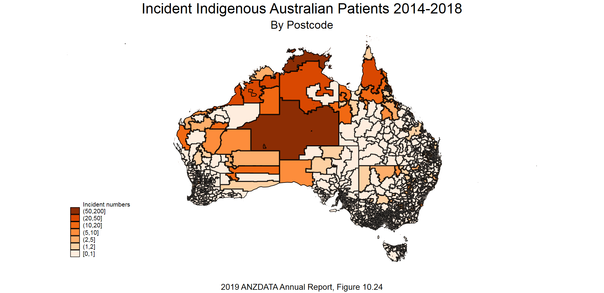

Slide 30
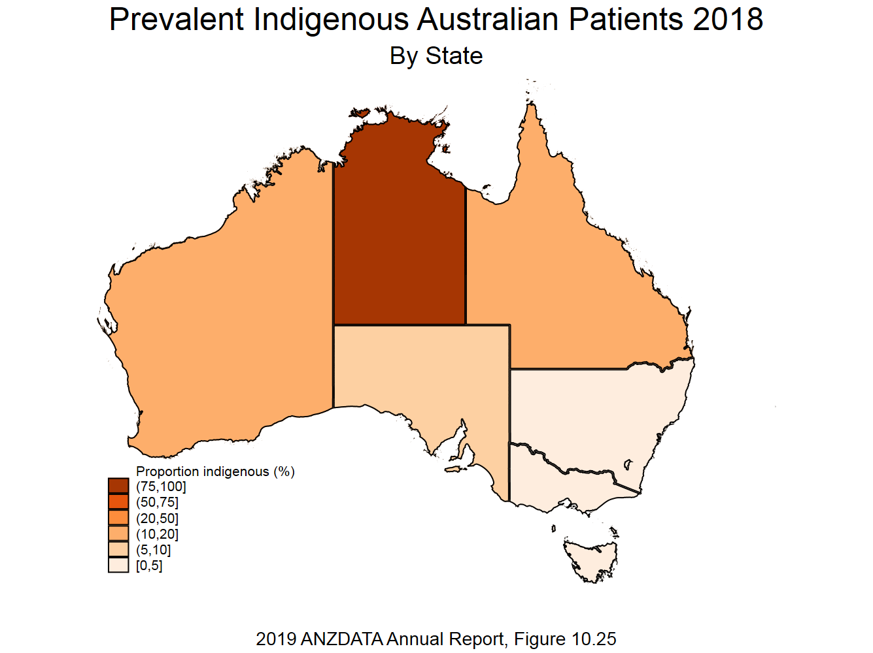

Slide 31
