Slide 1
ANZDATA Registry
39th Annual Report
Chapter 13: End Stage Kidney Disease in Aotearoa/New Zealand
Data to 31-Dec-2015

Slide 2
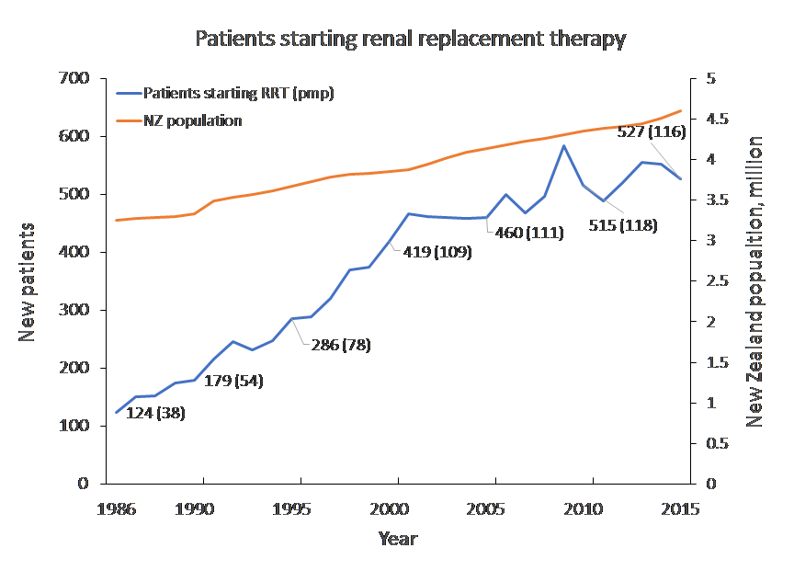
Figure 13.1 Incidence of renal replacement therapy,
New Zealand 1986-2015

Slide 3
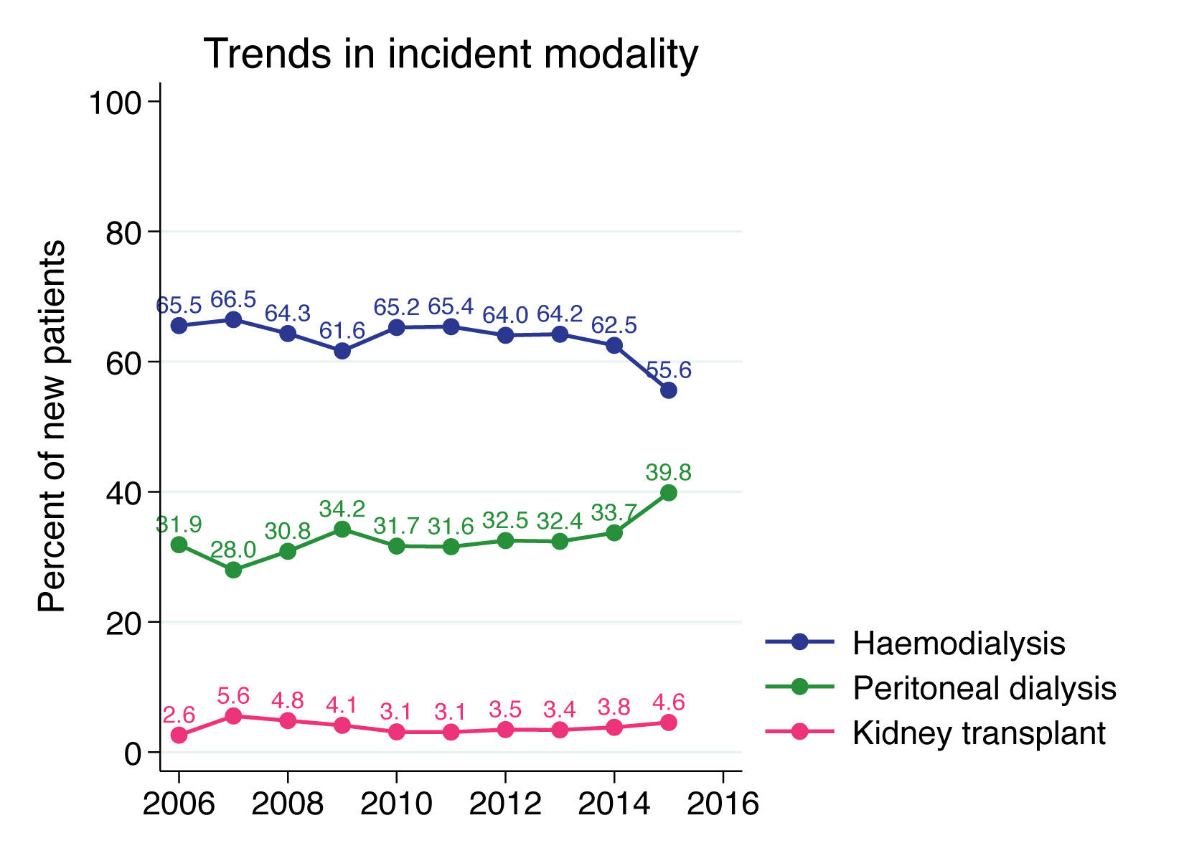
Figure 13.2 Trends in modality at start of renal replacement therapy, New Zealand 2006-2015

Slide 4
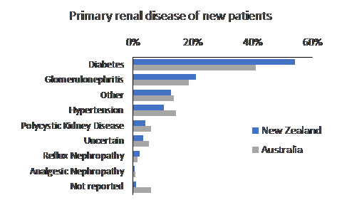
Figure 13.3 Primary renal disease in new patients commencing renal replacement therapy, 2015

Slide 5
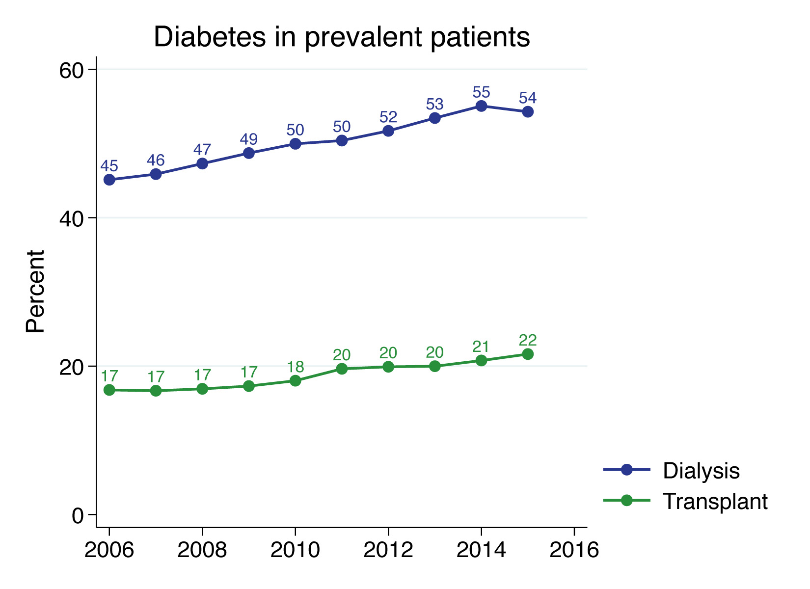
Figure 13.4 Proportion of patients with Diabetes as primary renal disease in New Zealand, 2006-2015

Slide 6
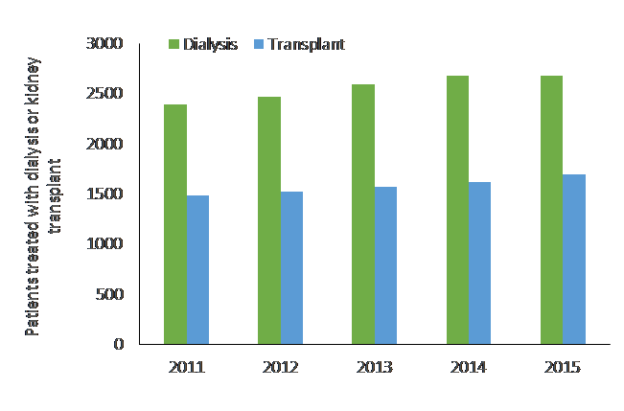
Figure 13.5 Prevalence of renal replacement therapy in New Zealand, 2011-2016

Slide 7
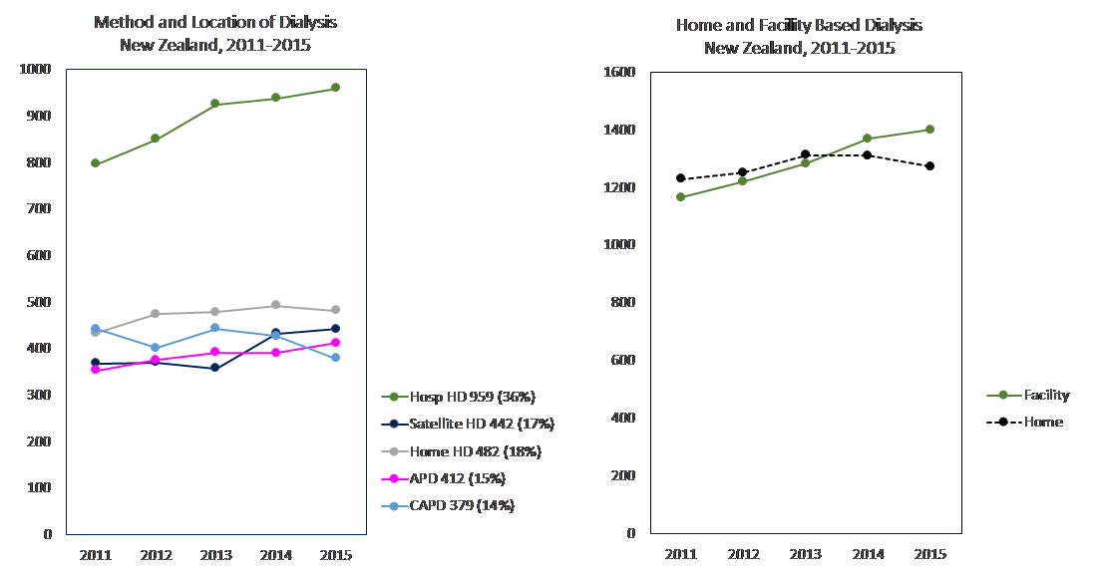
Figure 13.6 Methods and location of dialysis in New Zealand,
2011-2015

Slide 8
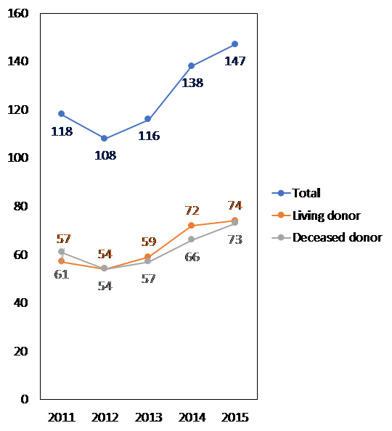
Figure 13.7 New Kidney transplants in New Zealand, 2011-2015

Slide 9
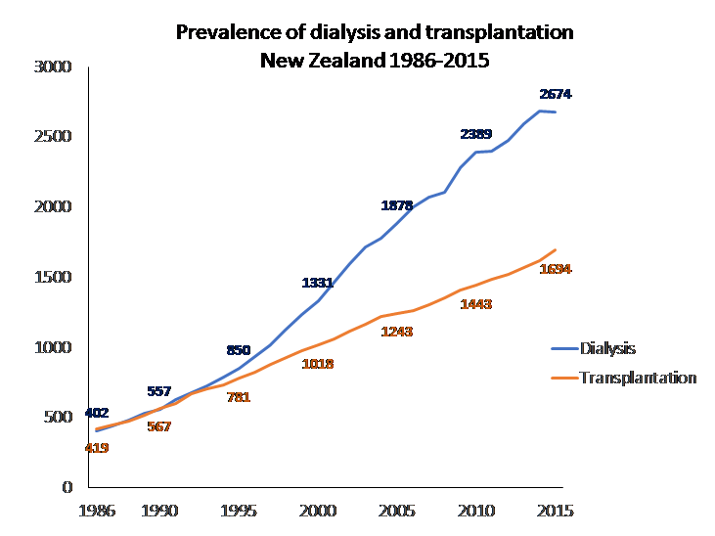
Figure 13.8 Overall number of patients treated with renal replacement therapy in New Zealand

Slide 10
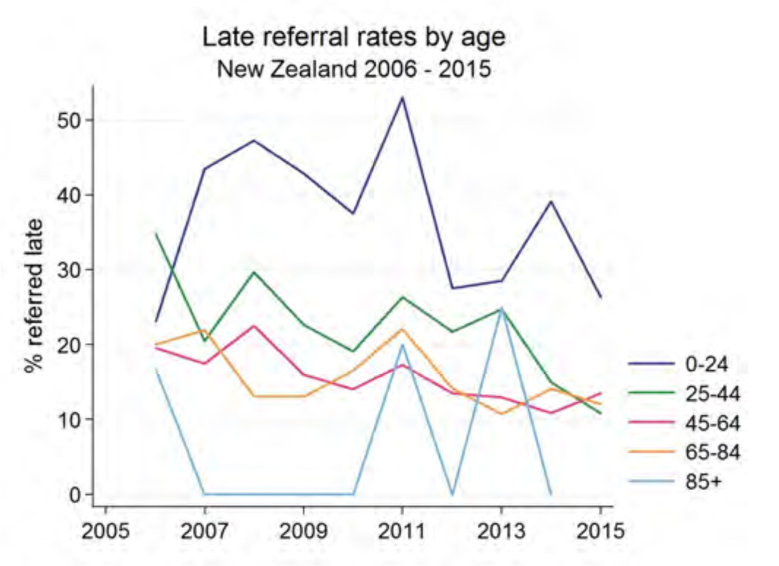
Figure 13.9 Late referral rates by age group, New Zealand

Slide 11
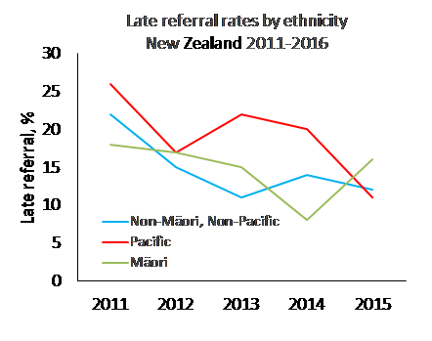
Figure 13.10 Late referral rates by ethnicity, New Zealand

Slide 12
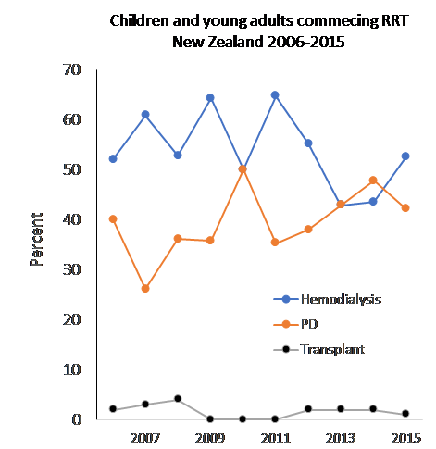
Figure 13.11 Children and young adults commencing renal replacement therapy in New Zealand, 2006-2016

Slide 13
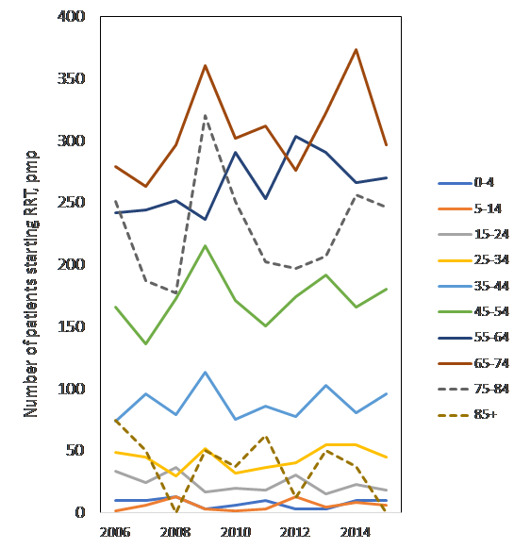
Figure 13.12 Incidence of renal replacement therapy by age in New Zealand, 2006-2015

Slide 14
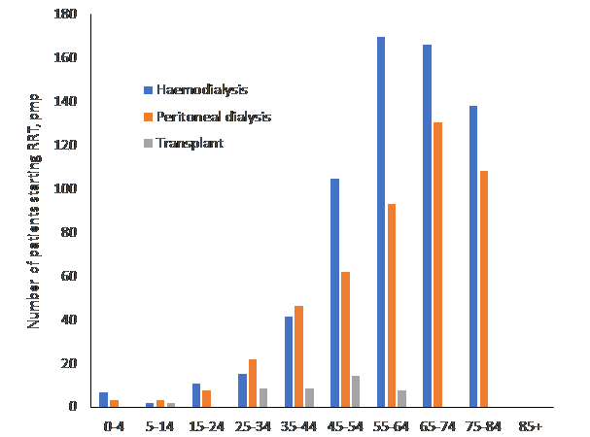
Figure 13.13 Incidence of renal replacement therapy by age and modality in New Zealand, 2006-2015

Slide 15
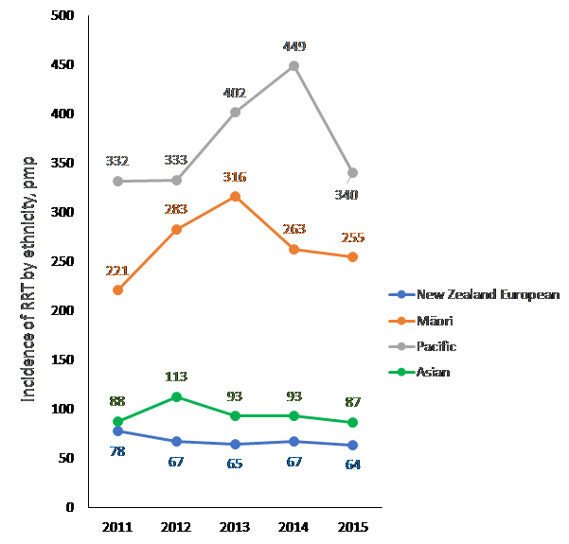
Figure 13.14 Incidence of RRT by ethnicity in New Zealand, 2011-2015

Slide 16
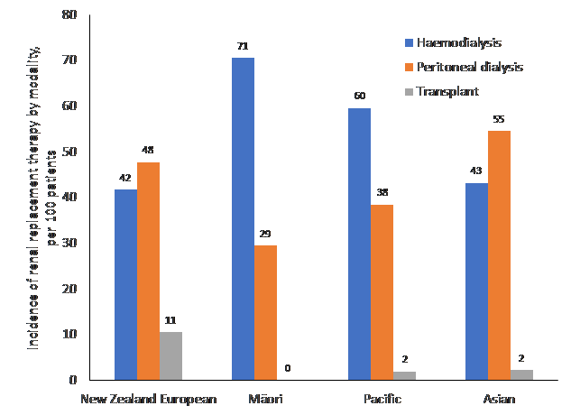
Figure 13.15 Incidence of RRT by ethnicity and modality in New Zealand, 2006-2015

Slide 17
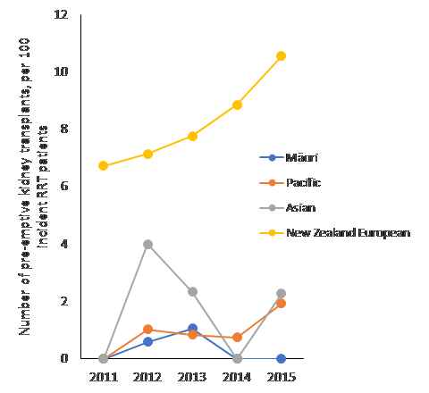
Figure 13.16 Pre-emptive kidney transplantation by ethnicity per 100 RRT patients in New Zealand, 2011-2015

