Slide 1

CHAPTER 6
PERITONAEAL DIALYSIS

Slide 2
Figure 6.1
Proportion (%) Peritoneal Dialysis of all Home Dialysis Patients 2006 - 2010
State | 2006 | 2007 | 2008 | 2009 | 2010
Queensland | 72% | 70% | 68% | 66% | 67%
New South Wales | 62% | 63% | 67% | 66% | 66%
Australian Capital Territory | 65% | 60% | 49% | 46% | 40%
Victoria | 690% | 66% | 67% | 67% | 66%
Tasmania | 81% | 87% | 83% | 82% | 79%
South Australia | 92% | 95% | 95% | 93% | 88%
Northern Territory | 65% | 67% | 63% | 57% | 59%
Western Australia | 89% | 90% | 89% | 87% | 83%
Australia | 69% | 69% | 70% | 69% | 68%
New Zealand | 70% | 69% | 70% | 68% | 66%

Slide 3
Figure 6.2
Continuous Period of Peritoneal Dialysis 1963 - 2010
 | Months
 | 0-<6 | 6-11 | 12-17 | 18-23 | 24-29 | 30-35 | 36-41 | 42-47 | 48-59 | 60-71 | 72-83 | 84-95 | 96-107 | ≥108
Australia
1st Treatment (n=21,436) | 6286 | 3828 | 2808 | 2151 | 1696 | 1177 | 878 | 661 | 909 | 489 | 251 | 145 | 79 | 78
All Treatments (n=25,940) | 7918 | 4720 | 3390 | 2577 | 1965 | 1359 | 1030 | 770 | 1036 | 557 | 277 | 161 | 84 | 96
New Zealand
1st Treatment (n=5,867) | 1107 | 880 | 747 | 685 | 529 | 449 | 361 | 259 | 405 | 194 | 106 | 64 | 41 | 40
All Treatments (n=6,968) | 1401 | 1078 | 905 | 796 | 614 | 515 | 421 | 287 | 445 | 218 | 121 | 72 | 45 | 50

Slide 4
Figure 6.3
Stock and Flow of Peritoneal Dialysis Patients 2006 - 2010
State | 2006 | 2007 | 2008 | 2009 | 2010
Australia
Patients new to PD | 1005 | 896 | 996 | 887 | 730
First Dialysis Treatment | 582 | 587 | 657 | 582 | 480
Previous Dialysis (HD) | 405 | 288 | 307 | 282 | 229
Failed Transplant | 18 | 21 | 32 | 23 | 21
Transplanted | 136 | 142 | 175 | 154 | 186
Deaths | 289 | 296 | 293 | 312 | 263
Never Transplanted | 281 | 292 | 279 | 302 | 259
Previous Transplant | 8 | 4 | 14 | 10 | 4
Transfer to Haemodialysis | 439 | 422 | 481 | 506 | 403
Patients Dialysing (PD) at 31 December | 2047 | 2137 | 2242 | 2195 | 2064
Patients Dialysing (PD) at Home at 31 December | 2015 | 2111 | 2206 | 2173 | 2050
% of all Home Dialysis Patients | 69% | 69% | 70% | 69% | 68%
New Zealand
Patients new to PD | 297 | 242 | 274 | 283 | 273
First Dialysis Treatment | 159 | 132 | 153 | 199 | 161
Previous Dialysis (HD) | 127 | 104 | 115 | 80 | 111
Failed Transplant | 11 | 6 | 6 | 4 | 1
Transplanted | 23 | 37 | 28 | 35 | 46
Deaths | 152 | 120 | 124 | 126 | 114
Never Transplanted | 149 | 113 | 117 | 124 | 109
Previous Transplant | 3 | 7 | 7 | 2 | 5
Transfer to Haemodialysis | 103 | 124 | 124 | 116 | 95
Patients Dialysing (PD) at 31 December | 766 | 746 | 763 | 799 | 834
Patients Dialysing (PD) at Home at 31 December | 758 | 742 | 758 | 795 | 829
% of all Home Dialysis Patients | 70% | 69% | 70% | 68% | 66%

Slide 5
Figure 6.4

Slide 6
Figure 6.5

Slide 7
Figure 6.6

Slide 8
Figure 6.7

Slide 9
Figure 6.8 |  |  |  |  | Australia
Stock and Flow of Peritoneal Dialysis by Age Groups 2006 - 2010
Age Groups | 2006 | 2007 | 2008 | 2009 | 2010
New Patients *
00-14 years | 16 (2%) | 22 (2%) | 14 (1%) | 25 (3%) | 19 (3%)
15-24 years | 20 (2%) | 18 (2%) | 32 (3%) | 26 (3%) | 17 (2%)
25-34 years | 60 (6%) | 43 (5%) | 51 (5%) | 54 (6%) | 42 (6%)
35-44 years | 96 (10%) | 93 (10%) | 99 (10%) | 74 (8%) | 76 (10%)
45-54 years | 170 (17%) | 161 (18%) | 175 (18%) | 127 (14%) | 130 (18%)
55-64 years | 217 (22%) | 198 (22%) | 217 (22%) | 196 (22%) | 163 (22%)
65-74 years | 249 (25%) | 203 (23%) | 229 (23%) | 224 (25%) | 176 (24%)
75-84 years | 168 (17%) | 150 (17%) | 167 (17%) | 143 (16%) | 99 (14%)
>=85 years | 9 (1%) | 8 (1%) | 12 (1%) | 18 (2%) | 8 (1%)
Total | 1005 (100%) | 896 (100%) | 996 (100%) | 887 (100%) | 730 (100%)
Patients Dialysing
00-14 years | 22 (1%) | 34 (2%) | 28 (1%) | 32 (1%) | 29 (1%)
15-24 years | 27 (1%) | 25 (1%) | 47 (2%) | 52 (2%) | 39 (2%)
25-34 years | 86 (4%) | 76 (4%) | 84 (4%) | 97 (4%) | 90 (4%)
35-44 years | 191 (9%) | 199 (9%) | 183 (8%) | 170 (8%) | 177 (9%)
45-54 years | 310 (15%) | 339 (16%) | 371 (17%) | 337 (15%) | 298 (14%)
55-64 years | 464 (23%) | 479 (22%) | 506 (23%) | 478 (22%) | 453 (22%)
65-74 years | 529 (26%) | 550 (26%) | 554 (25%) | 578 (26%) | 554 (27%)
75-84 years | 385 (19%) | 403 (19%) | 422 (19%) | 398 (18%) | 371 (18%)
>=85 years | 33 (2%) | 32 (1%) | 47 (2%) | 53 (2%) | 53 (3%)
Total | 2047 (100%) | 2137 (100%) | 2242 (100%) | 2195 (100%) | 2064 (100%)
Primary Renal Disease *
Glomerulonephritis | 266 (26%) | 231 (26%) | 260 (26%) | 250 (28%) | 197 (27%)
Analgesic Nephropathy | 26 (3%) | 17 (2%) | 28 (3%) | 13 (1%) | 14 (2%)
Hypertension | 137 (14%) | 131 (15%) | 118 (12%) | 147 (17%) | 92 (13%)
Polycystic Disease | 53 (5%) | 50 (6%) | 66 (7%) | 53 (6%) | 52 (7%)
Reflux Nephropathy | 43 (4%) | 29 (3%) | 40 (4%) | 38 (4%) | 22 (3%)
Diabetic Nephropathy | 324 (32%) | 284 (32%) | 327 (33%) | 266 (30%) | 238 (33%)
Miscellaneous | 106 (11%) | 96 (11%) | 80 (8%) | 82 (9%) | 78 (11%)
Uncertain | 50 (5%) | 58 (6%) | 77 (8%) | 38 (4%) | 37 (5%)
Total | 1005 (100%) | 896 (100%) | 996 (100%) | 887 (100%) | 730 (100%)
* New patients receiving first peritoneal dialysis treatment

Slide 10
Figure 6.9

Slide 11
Figure 6.10

Slide 12
Figure 6.11

Slide 13
Figure 6.12

Slide 14
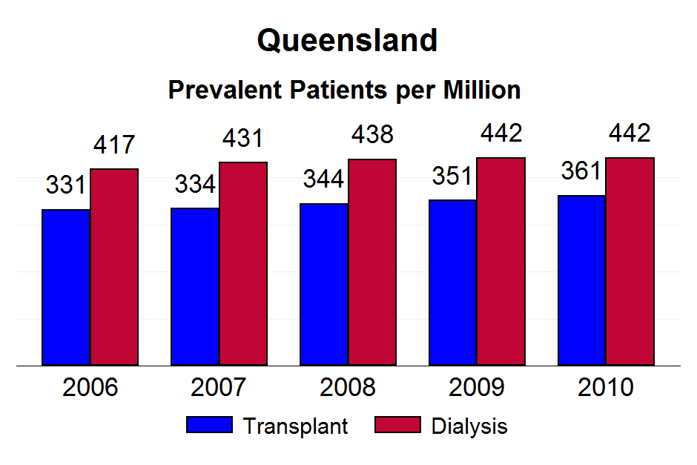

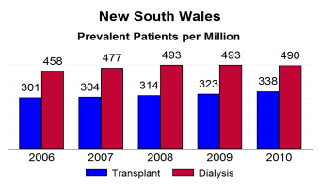

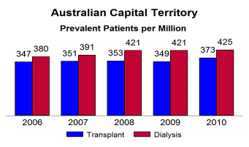
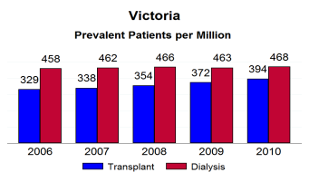
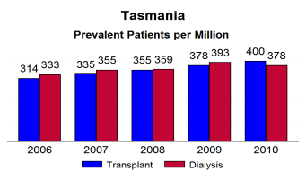
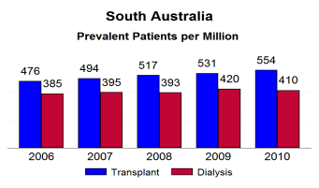
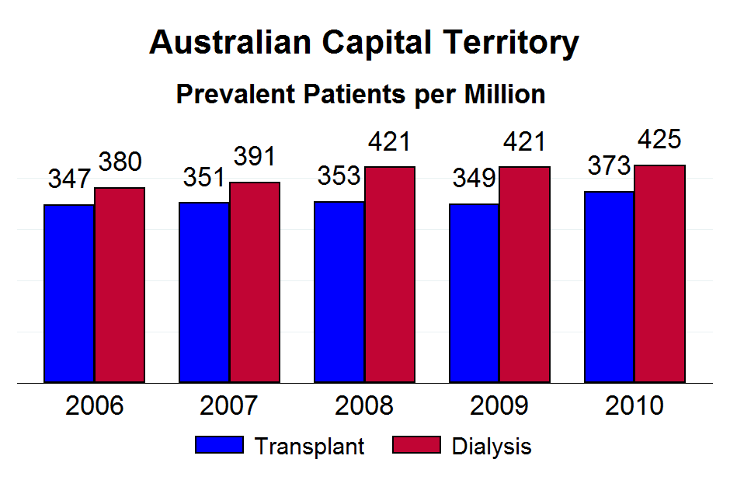

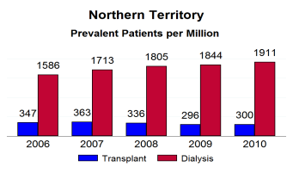
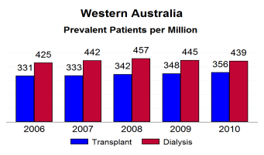




Figure 6.13

Slide 15
Figure 6.14

Slide 16
Figure 6.15

Slide 17
Figure 6.16

Slide 18
Figure 6.17 |  |  | New Zealand
Stock and Flow of Peritoneal Dialysis by Age Groups 2006 - 2010
Age Groups | 2006 | 2007 | 2008 | 2009 | 2010
New Patients *
00-14 years | 4 (1%) | 5 (2%) | 10 (4%) | 3 (1%) | 3 (1%)
15-24 years | 16 (5%) | 5 (2%) | 13 (5%) | 4 (1%) | 8 (3%)
25-34 years | 11 (4%) | 18 (7%) | 11 (4%) | 10 (4%) | 8 (3%)
35-44 years | 30 (10%) | 21 (9%) | 21 (8%) | 31 (11%) | 22 (8%)
45-54 years | 59 (20%) | 43 (18%) | 55 (20%) | 59 (21%) | 42 (15%)
55-64 years | 70 (24%) | 74 (31%) | 78 (28%) | 62 (22%) | 88 (32%)
65-74 years | 66 (22%) | 55 (23%) | 69 (25%) | 86 (30%) | 70 (26%)
75-84 years | 39 (13%) | 18 (7%) | 17 (6%) | 27 (10%) | 32 (12%)
>=85 years | 2 (1%) | 3 (1%) |  | 1 (0%)
Total | 297 (100%) | 242 (100%) | 274 (100%) | 283 (100%) | 273 (100%)
Patients Dialysing
00-14 years | 8 (1%) | 8 (1%) | 13 (2%) | 10 (1%) | 7 (1%)
15-24 years | 21 (3%) | 23 (3%) | 28 (4%) | 27 (3%) | 22 (3%)
25-34 years | 35 (5%) | 36 (5%) | 30 (4%) | 33 (4%) | 29 (3%)
35-44 years | 68 (9%) | 63 (8%) | 62 (8%) | 62 (8%) | 67 (8%)
45-54 years | 131 (17%) | 121 (16%) | 141 (18%) | 157 (20%) | 139 (17%)
55-64 years | 185 (24%) | 195 (26%) | 209 (27%) | 212 (27%) | 237 (28%)
65-74 years | 198 (26%) | 186 (25%) | 186 (24%) | 216 (27%) | 231 (28%)
75-84 years | 112 (15%) | 100 (13%) | 81 (11%) | 72 (9%) | 98 (12%)
>=85 years | 8 (1%) | 14 (2%) | 13 (2%) | 10 (1%) | 4 (0%)
Total | 766 (100%) | 746 (100%) | 763 (100%) | 799 (100%) | 834 (100%)
Primary Renal Disease *
Glomerulonephritis | 67 (23%) | 55 (23%) | 65 (24%) | 57 (20%) | 64 (23%)
Analgesic Nephropathy | 1 (0%) |  | 2 (1%) |  | 3 (1%)
Hypertension | 43 (14%) | 26 (11%) | 35 (13%) | 33 (12%) | 36 (13%)
Polycystic Disease | 25 (8%) | 11 (5%) | 12 (4%) | 18 (6%) | 7 (3%)
Reflux Nephropathy | 10 (3%) | 9 (4%) | 4 (1%) | 5 (2%) | 3 (1%)
Diabetic Nephropathy | 115 (39%) | 106 (44%) | 115 (42%) | 127 (45%) | 134 (49%)
Miscellaneous | 23 (8%) | 27 (11%) | 27 (10%) | 31 (11%) | 20 (7%)
Uncertain | 13 (4%) | 8 (3%) | 14 (5%) | 12 (4%) | 6 (2%)
Total | 297 (100%) | 242 (100%) | 274 (100%) | 283 (100%) | 273 (100%)
* New patients receiving first peritoneal dialysis treatment

Slide 19
Figure 6.18
Icodextrin Usage by Modality Type - December 2010
Modality Type | Australia |  |  |  | New Zealand
 | No | Yes | Total |  | No | Yes | Total
CAPD | 559 | 238 | 797 |  | 361 | 117 | 478
 | 70% | 30% | . |  | 76% | 24% | .
APD | 700 | 564 | 1264 |  | 121 | 234 | 355
 | 55% | 45% | . |  | 34% | 66% | .
Total | 1259 | 802 | 2061 |  | 482 | 351 | 833
 | 61% | 39% | . |  | 58% | 42% | .

Slide 20
Figure 6.19

Slide 21
Figure 6.20

Slide 22
Figure 6.21

Slide 23
Figure 6.22
Low GDP - Lactate Usage by Modality Type - December 2010
Modality Type | Australia |  |  |  | New Zealand
 | No | Yes | Total |  | No | Yes | Total
CAPD | 766 | 31 | 797 |  | 477 | 1 | 478
 | 96% | 4% | . |  | 100% | <1% | .
APD | 1222 | 42 | 1264 |  | 346 | 9 | 355
 | 97% | 3% | . |  | 97% | 3% | .
Total | 1988 | 73 | 2061 |  | 823 | 10 | 833
 | 96% | 4% | . |  | 99% | 1% | .

Slide 24
Figure 6.23

Slide 25
Figure 6.24

Slide 26
Figure 6.25
Low GDP - Bicarb Usage by Modality Type - December 2010
Modality Type | Australia |  |  |  | New Zealand
 | No | Yes | Total |  | No | Yes | Total
CAPD | 785 | 12 | 797 |  | 468 | 10 | 478
 | 98.% | 2% | . |  | 98% | 2% | .
APD | 1236 | 28 | 1264 |  | 348 | 7 | 355
 | 98% | 2% | . |  | 98% | 2% | .
Total | 2021 | 40 | 2061 |  | 816 | 17 | 833
 | 98% | 2% | . |  | 98% | 2% | .

Slide 27
Figure 6.26

Slide 28
Figure 6.27

Slide 29
Figure 6.28
Peritoneal Dialysis at 90 Days Patient Survival Censored for Transplant % [95% Confidence Interval]
Year of Starting | No. of Patients | Survival
 |  | 6 months | 1 year | 3 years | 5 years
Australia
1999-2001 | 1355 | 95 [94, 96] | 89 [87, 91] | 63 [60, 65] | 42 [39, 45]
2002-2004 | 1453 | 95 [94, 96] | 90 [88, 92] | 66 [64, 69] | 45 [42, 48]
2005-2007 | 1668 | 97 [96, 98] | 92 [90, 93] | 71 [68, 73] | 50 [47, 54]
2008-2010 | 1724 | 96 [95, 97] | 92 [91, 94] | - | -
New Zealand
1998-2001 | 499 | 96 [94, 98] | 89 [86, 92] | 63 [58, 67] | 38 [34, 43]
2002-2004 | 488 | 97 [95, 98] | 89 [86, 92] | 60 [56, 65] | 38 [34, 43]
2005-2007 | 439 | 97 [95, 99] | 92 [89, 94] | 70 [66, 75] | 50 [44, 56]
2008-2010 | 522 | 97 [95, 98] | 92 [89, 94] | - | -

Slide 30
Figure 6.29

Slide 31
Figure 6.30

Slide 32
Figure 6.31
Peritoneal Dialysis at 90 Days Patient Survival - Diabetic / Non Diabetic Censored for Transplant Commenced 1999 - 2010 % [95% Confidence Interval]
 | No. of Patients | Survival
 |  | 6 months | 1 year | 3 years | 5 years
Australia
Non Diabetic | 4351 | 97 [96, 97] | 92 [91, 93] | 71 [69, 72] | 52 [50, 54]
Diabetic | 1849 | 95 [94, 96] | 89 [87, 90] | 61 [58, 63] | 35 [32, 38]
New Zealand
Non Diabetic | 1134 | 96 [95, 97] | 92 [90, 93] | 69 [66, 72] | 49 [45, 53]
Diabetic | 814 | 98 [96, 99] | 90 [87, 92] | 60 [57, 64] | 33 [29, 37]

Slide 33
Figure 6.32

Slide 34
Figure 6.33

Slide 35
Figure 6.34
Peritoneal Dialysis at 90 Days Patient Survival - By Age Group Censored for Transplant 1999 - 2010 % [95% Confidence Interval]
Age Groups | No. of Patients | Survival
 |  | 6 months | 1 year | 3 years | 5 years
Australia
0-39 years | 877 | 99 [98, 99] | 98 [96, 99] | 90 [87, 93] | 80 [75, 85]
40-59 years | 1828 | 98 [97, 98] | 95 [94, 96] | 81 [79, 83] | 65 [62, 68]
60-74 years | 2348 | 96 [95, 97] | 89 [88, 90] | 64 [61, 66] | 40 [38, 43]
>=75 years | 1147 | 92 [91, 94] | 83 [81, 85] | 48 [44, 51] | 24 [21, 27]
New Zealand
0-39 years | 228 | 99 [96, 100] | 96 [93, 98] | 86 [78, 91] | 76 [65, 83]
40-59 years | 659 | 99 [98, 99] | 95 [93, 96] | 73 [69, 77] | 51 [46, 56]
60-74 years | 812 | 97 [95, 98] | 89 [86, 91] | 61 [57, 65] | 35 [31, 40]
>=75 years | 249 | 91 [87, 94] | 82 [76, 86] | 46 [39, 53] | 23 [17, 29]

Slide 36
Figure 6.35

Slide 37
Figure 6.36

Slide 38
Figure 6.37

Slide 39
Figure 6.38

Slide 40
Figure 6.39
Peritoneal Dialysis at 90 Days Technique Survival - Diabetic / Non Diabetic Censored for Transplant Commenced 1999 - 2010 % [95% Confidence Interval]
 | No. of Patients | Survival
 |  | 6 months | 1 year | 3 years | 5 years
Australia
Non Diabetic | 4351 | 86 [84, 87] | 73 [71, 74] | 37 [35, 39] | 18 [16, 19]
Diabetic | 1849 | 82 [80, 84] | 70 [68, 72] | 31 [28, 33] | 10 [9, 13]
New Zealand
Non Diabetic | 1134 | 90 [88, 92] | 80 [78, 83] | 46 [42, 49] | 22 [19, 26]
Diabetic | 814 | 90 [87, 92] | 77 [74, 80] | 40 [36, 43] | 13 [10, 16]

Slide 41
Figure 6.40

Slide 42
Figure 6.41

Slide 43
Figure 6.42
Peritoneal Dialysis at 90 Days Technique Survival - By Age Group Censored for Transplant 1999 - 2010 % [95% Confidence Interval]
Age Groups | No. of Patients | Survival
 |  | 6 months | 1 year | 3 years | 5 years
Australia
0-39 years | 877 | 89 [87, 91] | 78 [75, 81] | 46 [41, 51] | 28 [22, 35]
40-59 years | 1828 | 86 [84, 88] | 75 [73, 77] | 38 [35, 41] | 20 [18, 23]
60-74 years | 2348 | 83 [82, 85] | 71 [69, 73] | 34 [32, 37] | 15 [13, 17]
>=75 years | 1147 | 81 [78, 83] | 65 [62, 68] | 26 [24, 29] | 8 [6, 10]
New Zealand
0-39 years | 228 | 91 [87, 94] | 82 [76, 87] | 49 [40, 58] | 27 [18, 37]
40-59 years | 659 | 91 [89, 93] | 83 [79, 85] | 46 [42, 51] | 22 [18, 27]
60-74 years | 812 | 89 [87, 91] | 76 [73, 79] | 42 [38, 46] | 15 [12, 19]
>=75 years | 249 | 85 [80, 89] | 73 [67, 78] | 33 [27, 40] | 10 [6, 15]

Slide 44
Figure 6.43

Slide 45
Figure 6.44

Slide 46
Figure 6.45
Causes of Technique Failure 1-Jan-2009 to 31-Dec-2010 Excluding Death, Transplantation, Recovery of Renal Function
Causes of Technique Failure |  | Australia |  | New Zealand
Recurrent/persistent peritonitis |  | 188 |  | 80
Acute peritonitis |  | 284 |  | 54
Tunnel/exit site infection |  | 40 |  | 5
Total Infective Causes |  | 512 (25%) |  | 139 (22%)
Inadequate solute clearance |  | 242 |  | 106
Inadequate fluid ultrafiltration |  | 90 |  | 64
Excessive fluid ultrafiltration |  | 5 |  | 5
Total Dialysis Failure |  | 337 (16%) |  | 175 (28%)
Dialysate leak |  | 75 |  | 30
Hydrothorax |  | 7
Scrotal oedema |  | 13 |  | 2
Catheter block |  | 53 |  | 13
Catheter fell out |  | 5 |  | 2
Hernia |  | 58 |  | 11
Abdominal pain |  | 17 |  | 7
Abdominal surgery |  | 37 |  | 14
Other surgery |  | 19 |  | 4
Haemoperitoneum |  |  |  | 2
Sclerosing peritonitis |  | 1 |  | 3
Miscellaneous |  | 68 |  | 8
Multiple adhesions |  | 3 |  | 5
Total Technical Failure |  | 356(17%) |  | 101 (16%)
Unable to manage self care |  | 116 |  | 31
Patient preference |  | 752 |  | 184
Transfer outside Australia/NZ |  | 8 |  | 1
Total Social Reasons |  | 876 (42%) |  | 216 (34%)

Slide 47
Figure 6.46
First PD Treatment to First Episode of Peritonitis Related to Age at Entry 01-Jan-2006 to 31-Dec-2010
Survival | Age Groups |  |  |  |  |  | All
 | 00-14 | 15-34 | 35-54 | 55-64 | 65-74 | >=75
Australia | (n=96) | (n=363) | (n=1201) | (n=991) | (n=1081) | (n=782) | (n=4514)
3 months | 80 [70,87] | 86 [82,89] | 86 [84,88] | 87 [85,89] | 88 [86,90] | 87 [84,89] | 87 [86,88]
6 months | 69 [59,78] | 78 [73,82] | 78 [76,81] | 79 [76,82] | 81 [78,83] | 79 [75,81] | 79 [78,80]
9 months | 57 [46,67] | 71 [66,76] | 71 [69,74] | 71 [67,73] | 73 [70,76] | 72 [68,75] | 71 [70,73]
1 year | 56 [44,66] | 66 [60,71] | 65 [62,68] | 64 [61,68] | 67 [64,70] | 64 [60,68] | 65 [64,67]
2 years | 34 [19,49] | 48 [41,55] | 46 [43,50] | 44 [40,48] | 47 [43,51] | 45 [40,50] | 46 [44,47]
3 years | 19 [5,40] | 31 [22,40] | 30 [26,34] | 32 [27,37] | 29 [25,34] | 31 [26,37] | 30 [28,32]
New Zealand | (n=25) | (n=104) | (n=383) | (n=372) | (n=346) | (n=139) | (n=1369)
3 months | 70 [47,85] | 84 [75,90] | 89 [85,92] | 83 [79,87] | 85 [81,89] | 89 [82,93] | 86 [84,88]
6 months | 47 [26,66] | 77 [67,84] | 78 [73,82] | 72 [67,77] | 77 [72,81] | 83 [75,89] | 76 [73,78]
9 months | 35 [16,55] | 63 [51,72] | 68 [62,73] | 65 [59,70] | 66 [60,71] | 70 [61,78] | 66 [63,68]
1 year | 28 [10,49] | 60 [48,70] | 61 [55,66] | 59 [53,64] | 58 [52,64] | 64 [54,73] | 59 [56,62]
2 years | 28 [10,49] | 40 [28,52] | 39 [32,45] | 41 [35,47] | 43 [36,50] | 35 [24,47] | 40 [36,43]
3 years | - | 17 [7,31] | 29 [23,36] | 32 [25,39] | 31 [23,38] | 21 [10,34] | 28 [25,32]
% Survival [95% Confidence Interval]

Slide 48
Figure 6.47

Slide 49
Figure 6.48

Slide 50
Figure 6.49 - Aust

Slide 51
Figure 6.49 - Aust

Slide 52
Figure 6.50 - NZ

Slide 53
Figure 6.50 - NZ

Slide 54
Figure 6.51
First Home APD Treatment to First Episode of Peritonitis Related to Age at Entry 01-Jan-2006 to 31-Dec-2010
Survival | Age Groups |  |  |  |  |  | All
 | 00-14 | 15-34 | 35-54 | 55-64 | 65-74 | >=75
Australia | (n=140) | (n=424) | (n=1225) | (n=932) | (n=1004) | (n=645) | (n=4370)
3 months | 81 [73, 87] | 88 [84, 90] | 87 [85, 89] | 90 [88, 92] | 90 [88, 91] | 90 [88, 92] | 89 [88, 90]
6 months | 71 [62, 78] | 81 [76, 84] | 78 [75, 80] | 83 [80, 85] | 80 [78, 83] | 83 [80, 86] | 80 [79, 82]
9 months | 61 [51, 69] | 74 [69, 78] | 71 [68, 73] | 76 [72, 78] | 73 [70, 76] | 74 [70, 78] | 73 [71, 74]
1 year | 57 [47, 66] | 68 [63, 73] | 65 [62, 68] | 68 [64, 71] | 68 [65, 72] | 67 [63, 71] | 67 [65, 68]
2 years | 38 [26, 50] | 43 [36, 50] | 45 [42, 49] | 48 [44, 52] | 49 [45, 53] | 47 [42, 52] | 47 [45, 49]
3 years | 25 [12, 40] | 34 [27, 42] | 31 [27, 36] | 33 [29, 38] | 35 [30, 39] | 35 [29, 41] | 33 [31, 35]
New Zealand | (n=49) | (n=100) | (n=266) | (n=192) | (n=157) | (n=77) | (n=841)
3 months | 79 [65, 88] | 82 [73, 89] | 87 [82, 90] | 89 [83, 92] | 87 [80, 91] | 85 [74, 91] | 86 [83, 88]
6 months | 59 [44, 72] | 76 [66, 84] | 76 [70, 81] | 80 [73, 85] | 72 [64, 79] | 76 [64, 84] | 75 [72, 78]
9 months | 49 [33, 63] | 62 [51, 72] | 65 [59, 71] | 68 [60, 75] | 63 [54, 71] | 62 [49, 73] | 64 [60, 67]
1 year | 41 [26, 56] | 57 [45, 67] | 59 [53, 66] | 57 [48, 65] | 53 [44, 61] | 52 [39, 64] | 56 [52, 59]
2 years | 31 [15, 48] | 35 [24, 46] | 42 [34, 49] | 40 [31, 49] | 32 [23, 41] | 22 [10, 37] | 36 [32, 41]
3 years | 12 [1, 36] | 21 [11, 33] | 28 [20, 36] | 27 [18, 38] | 16 [8, 27] | 18 [7, 33] | 23 [19, 28]
% Survival [95% Confidence Interval]

Slide 55
Figure 6.52 - Aust

Slide 56
Figure 6.52 - NZ

Slide 57
Figure 6.53
Number of Peritonitis Episodes
Year | Number
2003 | 250 (3 months data only)
2004 | 1,196
2005 | 1.072
2006 | 1,116
2007 | 1,254
2008 | 1,369
2009 | 1,344
2010 | 1,135
Total | 8,736

Slide 58
Figure 6.54

Slide 59
Figure 6.55

Slide 60
Figure 6.56

Slide 61
Figure 6.57

Slide 62
Figure 6.58

Slide 63
Figure 6.59

Slide 64
Figure 6.60

Slide 65
Figure 6.61

Slide 66
Figure 6.62

Slide 67
Figure 6.63

Slide 68
Figure 6.64

Slide 69
Figure 6.65 - Aust

Slide 70
Figure 6.65 - NZ

Slide 71
Figure 6.66

Slide 72
Figure 6.67

Slide 73
Figure 6.68

Slide 74
Figure 6.69

Slide 75
Figure 6.70

Slide 76
Figure 6.71

Slide 77
Figure 6.72

Slide 78
Figure 6.73

Slide 79
Figure 6.74

Slide 80
Figure 6.75

Slide 81
Figure 6.76

Slide 82
Figure 6.77

Slide 83
Figure 6.78

Slide 84
Figure 6.79

Slide 85
Figure 6.80

Slide 86
Figure 6.81

Slide 87
Figure 6.82

Slide 88
Figure 6.83

Slide 89
Figure 6.84

