Slide 1

CHAPTER 5
HAEMODIALYSIS

Slide 2
Figure 5.1
Stock and Flow of Haemodialysis Patients 2006 - 2010
 | 2006 | 2007 | 2008 | 2009 | 2010
Australia
Patients new to HD | 2062 | 2021 | 2149 | 2056 | 1986
First Dialysis Treatment | 1777 | 1730 | 1788 | 1703 | 1676
Previous Dialysis (PD) | 253 | 268 | 321 | 314 | 276
Failed Transplant | 32 | 23 | 40 | 39 | 34
Transplanted | 427 | 405 | 535 | 495 | 548
Deaths | 1036 | 1163 | 1201 | 1226 | 1138
Never Transplanted | 962 | 1084 | 1138 | 1150 | 1070
Previous Transplant | 74 | 79 | 63 | 76 | 68
Transfer to Peritoneal Dialysis | 534 | 436 | 487 | 428 | 328
Patients Dialysing (HD) at 31 December | 7216 | 7592 | 7919 | 8232 | 8527
Patients Dialysing (HD) at Home at 31 December | 894 | 949 | 950 | 972 | 964
% of all Home Dialysis (HD and PD) Patients | 31% | 31% | 30% | 31% | 32%
New Zealand
Patients new to HD | 407 | 380 | 394 | 429 | 391
First Dialysis Treatment | 327 | 311 | 320 | 360 | 326
Previous Dialysis (PD) | 70 | 57 | 66 | 59 | 58
Failed Transplant | 10 | 12 | 8 | 10 | 7
Transplanted | 51 | 60 | 69 | 61 | 47
Deaths | 181 | 177 | 236 | 205 | 205
Never Transplanted | 166 | 167 | 219 | 192 | 182
Previous Transplant | 15 | 10 | 17 | 13 | 23
Transfer to Peritoneal Dialysis | 179 | 146 | 158 | 118 | 147
Patients Dialysing (HD) at 31 December | 1231 | 1325 | 1343 | 1481 | 1545
Patients Dialysing (HD) at Home at 31 December | 322 | 327 | 330 | 377 | 422
% of all Home Dialysis (HD and PD) Patients | 30% | 31% | 30% | 32% | 34%

Slide 3
Figure 5.2

Slide 4
Figure 5.3
Stock and Flow of Haemodialysis Patients Australia 2006 - 2010 Number (%)
Age Groups | 2006 | 2007 | 2008 | 2009 | 2010
New Patients *
00-14 years | 13 (1%) | 9 (0%) | 13 (1%) | 9 (0%) | 13 (1%)
15-24 years | 34 (2%) | 45 (2%) | 42 (2%) | 45 (2%) | 42 (2%)
25-34 years | 77 (4%) | 94 (5%) | 101 (5%) | 89 (4%) | 75 (4%)
35-44 years | 198 (10%) | 187 (9%) | 172 (8%) | 176 (9%) | 166 (8%)
45-54 years | 296 (14%) | 315 (16%) | 345 (16%) | 312 (15%) | 308 (16%)
55-64 years | 454 (22%) | 437 (22%) | 447 (21%) | 442 (21%) | 430 (22%)
65-74 years | 532 (26%) | 485 (24%) | 541 (25%) | 513 (25%) | 472 (24%)
75-84 years | 413 (20%) | 405 (20%) | 431 (20%) | 411 (20%) | 397 (20%)
>=85 years | 45 (2%) | 44 (2%) | 57 (3%) | 59 (3%) | 83 (4%)
Total | 2062 (100%) | 2021 (100%) | 2149 (100%) | 2056 (100%) | 1986 (100%)
Patients Dialysing
00-14 years | 7 (0%) | 5 (0%) | 10 (0%) | 9 (0%) | 10 (0%)
15-24 years | 94 (1%) | 98 (1%) | 88 (1%) | 91 (1%) | 98 (1%)
25-34 years | 301 (4%) | 305 (4%) | 290 (4%) | 293 (4%) | 286 (3%)
35-44 years | 697 (10%) | 737 (10%) | 692 (9%) | 692 (8%) | 684 (8%)
45-54 years | 1142 (16%) | 1210 (16%) | 1274 (16%) | 1314 (16%) | 1310 (15%)
55-64 years | 1568 (22%) | 1618 (21%) | 1719 (22%) | 1775 (22%) | 1841 (22%)
65-74 years | 1753 (24%) | 1804 (24%) | 1894 (24%) | 1980 (24%) | 2052 (24%)
75-84 years | 1469 (20%) | 1602 (21%) | 1685 (21%) | 1766 (21%) | 1854 (22%)
>=85 years | 185 (3%) | 213 (3%) | 267 (3%) | 312 (4%) | 392 (5%)
Total | 7216 (100%) | 7592 (100%) | 7919 (100%) | 8232 (100%) | 8527 (100%)
Primary Renal Disease *
Glomerulonephritis | 463 (22%) | 482 (24%) | 462 (21%) | 504 (25%) | 417 (21%)
Analgesic Nephropathy | 48 (2%) | 46 (2%) | 45 (2%) | 39 (2%) | 38 (2%)
Hypertension | 307 (15%) | 319 (16%) | 322 (15%) | 285 (14%) | 278 (14%)
Polycystic Disease | 134 (6%) | 127 (6%) | 125 (6%) | 123 (6%) | 130 (7%)
Reflux Nephropathy | 62 (3%) | 56 (3%) | 59 (3%) | 61 (3%) | 42 (2%)
Diabetic Nephropathy | 681 (33%) | 642 (32%) | 746 (35%) | 680 (33%) | 722 (36%)
Miscellaneous | 252 (12%) | 217 (11%) | 233 (11%) | 230 (11%) | 240 (12%)
Uncertain | 115 (6%) | 132 (7%) | 157 (7%) | 134 (7%) | 119 (6%)
Total | 2062 (100%) | 2021 (100%) | 2149 (100%) | 2056 (100%) | 1986 (100%)
* New patients receiving first haemodialysis treatment

Slide 5
Figure 5.4

Slide 6
Figure 5.5
Stock and Flow of Haemodialysis Patients New Zealand 2006 - 2010 Number (%)
Age Groups | 2006 | 2007 | 2008 | 2009 | 2010
New Patients *
00-14 years | 3 (1%) | 3 (1%) | 5 (1%) | 2 (0%) | 1 (0%)
15-24 years | 15 (4%) | 21 (6%) | 19 (5%) | 10 (2%) | 12 (3%)
25-34 years | 30 (7%) | 17 (4%) | 15 (4%) | 24 (6%) | 12 (3%)
35-44 years | 33 (8%) | 45 (12%) | 34 (9%) | 54 (13%) | 39 (10%)
45-54 years | 92 (23%) | 63 (17%) | 84 (21%) | 89 (21%) | 96 (25%)
55-64 years | 96 (24%) | 100 (26%) | 117 (30%) | 103 (24%) | 108 (28%)
65-74 years | 94 (23%) | 88 (23%) | 89 (23%) | 92 (21%) | 82 (21%)
75-84 years | 40 (10%) | 39 (10%) | 30 (8%) | 52 (12%) | 38 (10%)
>=85 years | 4 (1%) | 4 (1%) | 1 (0%) | 3 (1%) | 3 (1%)
Total | 407 (100%) | 380 (100%) | 394 (100%) | 429 (100%) | 391 (100%)
Patients Dialysing
00-14 years | 2 (0%) | 3 (0%) | 3 (0%) | 3 (0%) | 4 (0%)
15-24 years | 32 (3%) | 39 (3%) | 38 (3%) | 41 (3%) | 45 (3%)
25-34 years | 88 (7%) | 80 (6%) | 76 (6%) | 90 (6%) | 89 (6%)
35-44 years | 150 (12%) | 160 (12%) | 149 (11%) | 162 (11%) | 164 (11%)
45-54 years | 247 (20%) | 261 (20%) | 275 (20%) | 309 (21%) | 328 (21%)
55-64 years | 347 (28%) | 364 (27%) | 373 (28%) | 403 (27%) | 427 (28%)
65-74 years | 269 (22%) | 297 (22%) | 293 (22%) | 315 (21%) | 322 (21%)
75-84 years | 87 (7%) | 108 (8%) | 126 (9%) | 147 (10%) | 152 (10%)
>=85 years | 9 (1%) | 13 (1%) | 10 (1%) | 11 (1%) | 14 (1%)
Total | 1231 (100%) | 1325 (100%) | 1343 (100%) | 1481 (100%) | 1545 (100%)
Primary Renal Disease *
Glomerulonephritis | 92 (23%) | 89 (23%) | 72 (18%) | 96 (22%) | 88 (23%)
Analgesic Nephropathy | 1 (0%) | 3 (1%) | 1 (0%) | 1 (0%)
Hypertension | 39 (10%) | 43 (11%) | 33 (8%) | 44 (10%) | 38 (10%)
Polycystic Disease | 23 (6%) | 15 (4%) | 14 (4%) | 18 (4%) | 11 (3%)
Reflux Nephropathy | 7 (2%) | 8 (2%) | 9 (2%) | 3 (1%) | 6 (2%)
Diabetic Nephropathy | 184 (45%) | 163 (43%) | 204 (52%) | 212 (49%) | 202 (52%)
Miscellaneous | 32 (8%) | 47 (12%) | 46 (12%) | 41 (10%) | 35 (9%)
Uncertain | 29 (7%) | 12 (3%) | 15 (4%) | 14 (3%) | 11 (3%)
Total | 407 (100%) | 380 (100%) | 394 (100%) | 429 (100%) | 391 (100%)
* New patients receiving first haemodialysis treatment

Slide 7
Figure 5.6

Slide 8
Figure 5.7

Slide 9
Figure 5.8

Slide 10
Figure 5.9

Slide 11
Figure 5.10
Blood Flow Rates (mls/minute) 2006 - 2010
Country |  | No. Pts | * | Mls/Minute
 |  |  |  | <200 | 200-249 | 250-299 | 300-349 | 350-399 | >400
Aust | December 2010 | 8524 | 3 | 0.50% | 3.50% | 14.30% | 57.90% | 20.10% | 3.70%
 | December 2009 | 8231 | 1 | 0.60% | 3.50% | 14.60% | 57.50% | 19.80% | 4%
 | December 2008 | 7919 |  | 0.70% | 4.40% | 16.20% | 54.80% | 20% | 3.90%
 | December 2007 | 7590 | 2 | 0.50% | 4.50% | 18.40% | 53.20% | 19.50% | 3.90%
 | December 2006 | 7215 | 1 | 0.40% | 4.50% | 19.30% | 52.30% | 19.10% | 4.40%
NZ | December 2010 | 1545 |  | 0.30% | 6.20% | 25.40% | 49.30% | 16.70% | 2.10%
 | December 2009 | 1480 | 1 | 0.30% | 6.40% | 24.90% | 45.90% | 20.20% | 2.30%
 | December 2008 | 1343 |  | 0.40% | 7.50% | 31.70% | 41.20% | 17.30% | 1.90%
 | December 2007 | 1325 |  | 0.50% | 6.60% | 28.80% | 41.10% | 21% | 2.10%
 | December 2006 | 1231 |  | 0.40% | 6.90% | 26.30% | 44.80% | 19.50% | 2.10%

Slide 12
Figure 5.11
Blood Flow Rate by Type of Access December 2010
Blood Flow Rate | Australia |  |  | New Zealand
 | AVF | AVG | CVC * | AVF | AVG | CVC
<200 | 22 (.3%) | - | 17 (1.5%) | 2 (.2%) | 1 (1.3%) | 2 (.6%)
200-249 | 204 (3.1%) | 26 (3.5%) | 67 (5.7%) | 73 (6.5%) | 2 (2.6%) | 21 (6.1%)
250-299 | 805 (12.2%) | 119 (15.9%) | 298 (25.6%) | 199 (17.7%) | 24 (30.8%) | 169 (49.4%)
300-349 | 3793 (57.4%) | 467 (62.5%) | 679 (58.2%) | 582 (51.7%) | 48 (61.5%) | 132 (38.6%)
350-399 | 1498 (22.7%) | 115 (15.4%) | 101 (8.7%) | 238 (21.2%) | 3 (3.8%) | 17 (5%)
>=400 | 289 (4.4%) | 20 (2.7%) | 4 (.3%) | 31 (2.8%) | - | 1 (.3%)
Total | 6611 (100%) | 747 (100%) | 1166 (100%) | 1125 (100%) | 78 (100%) | 342 (100%)

Slide 13
Figure 5.12

Slide 14
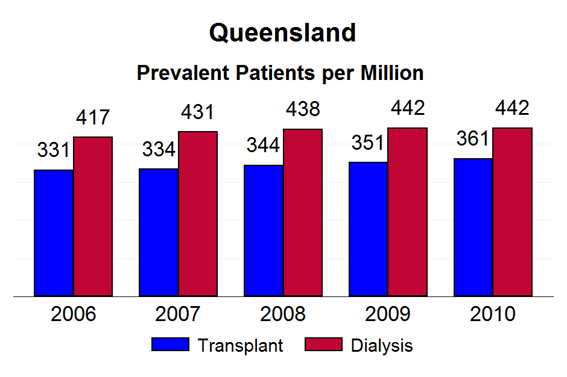

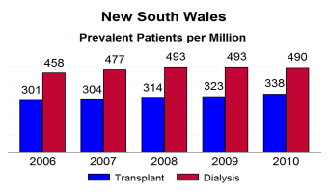

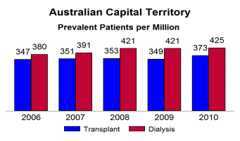
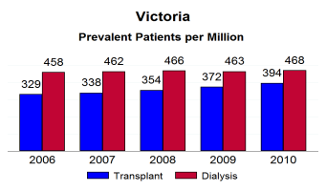
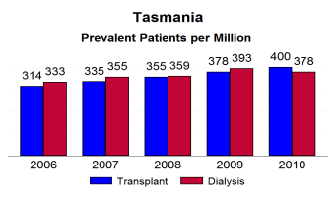
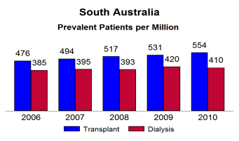
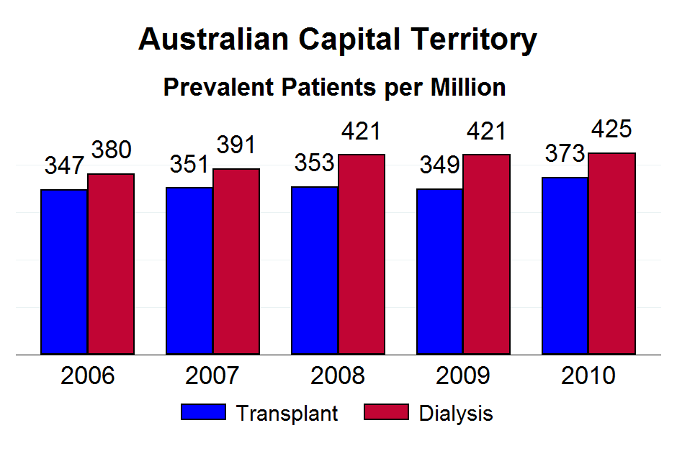

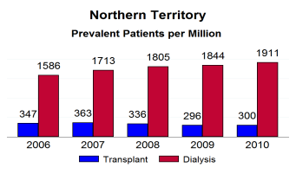
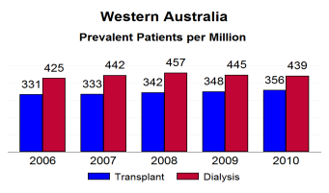




Figure 5.13

Slide 15
Figure 5.14
Duration and Number of Sessions Per Week December 2010
Sessions Per week | Hours of Each Treatment |  |  |  |  |  | Total
 | <4 | 4 | 4>4-4.5 | >4.5-5 | >5-5.5 | >5.5
Australia
<=3 | 343 (4.4%) | 3240 (41.8%) | 1638 (21.1%) | 2198 (28.4%) | 138 (1.8%) | 192 (2.5%) | 7749 (100%)
>3-<5 | 42 (7.8%) | 88 (16.3%) | 51 (9.4%) | 105 (19.4%) | 9 (1.7%) | 245 (45.4%) | 540 (100%)
>=5 | 71 (45.8%) | 33 (21.3%) | 2 (1.3%) | 9 (5.8%) | 1 (.6%) | 39 (25.2%) | 155 (100%)
Total | 456 (5.4%) | 3361 (39.8%) | 1691 (20%) | 2312 (27.4%) | 148 (1.8%) | 476 (5.6%) | 8444 (100%)
New Zealand
<=3 | 22 (1.6%) | 510 (37.7%) | 272 (20.1%) | 448 (33.1%) | 30 (2.2%) | 71 (5.2%) | 1353 (100%)
>3-<5 | 8 (5.3%) | 33 (22%) | 10 (6.7%) | 54 (36%) | 10 (6.7%) | 35 (23.3%) | 150 (100%)
>=5 | 14 (50%) | 8 (28.6%) | 2 (7.1%) | 3 (10.7%) | - | 1 (3.6%) | 28 (100%)
Total | 44 (2.9%) | 551 (36%) | 284 (18.5%) | 505 (33%) | 40 (2.6%) | 107 (7%) | 1531 (100%)

Slide 16
Figure 5.15

Slide 17
Figure 5.16

Slide 18
Figure 5.17

Slide 19
Figure 5.18

Slide 20
Figure 5.19

Slide 21
Figure 5.20

Slide 22
Figure 5.21
Haemodialysis Percentage ≥ 5 Sessions per Week By Australian State and Country
 | Australia |  |  |  |  |  |  | New Zealand
 | Qld | NSW/ACT | Vic | Tas | SA | NT | WA
Dec-10 | 49 (3.1%) | 26 (.9%) | 48 (2.2%) | 3 (2.1%) | 8 (1.4%) | 6 (1.5%) | 15 (1.9%) | 28 (1.8%)
Dec-09 | 40 (2.6%) | 27 (1%) | 39 (1.8%) | 2 (1.4%) | 6 (1.1%) | - | 10 (1.3%) | 28 (1.9%)
Dec-08 | 50 (3.4%) | 23 (.9%) | 45 (2.2%) | 2 (1.6%) | 8 (1.7%) | 1 (.3%) | 12 (1.6%) | 34 (2.5%)
Dec-07 | 57 (4.2%) | 26 (1%) | 53 (2.6%) | 1 (.8%) | 9 (1.9%) | - | 14 (2%) | 27 (2.1%)

Slide 23
Figure 5.22
Haemodialysis Percentage ≥ 4.5 Hours Per Session Three Sessions per Week By Australian State and Country
 | Australia |  |  |  |  |  |  | New Zealand
 | Qld | NSW/ACT | Vic | Tas | SA | NT | WA
Dec-10 | 809 (50.8%) | 1820 (65.9%) | 744 (33.7%) | 77 (53.8%) | 137 (24.4%) | 295 (73.9%) | 198 (25.2%) | 816 (53.2%)
Dec-09 | 769 (49.9%) | 1717 (64.5%) | 661 (31.3%) | 75 (53.6%) | 133 (25%) | 304 (79.6%) | 191 (24.8%) | 748 (51%)
Dec-08 | 716 (49.4%) | 1713 (66.1%) | 640 (31%) | 52 (41.6%) | 105 (21.8%) | 276 (76.7%) | 177 (23.2%) | 650 (48.7%)
Dec-07 | 678 (49.7%) | 1659 (66%) | 611 (30.5%) | 43 (35%) | 121 (25.2%) | 278 (83.2%) | 186 (26.1%) | 724 (55.1%)

Slide 24
Figure 5.23
Haemodialysis Percentage >12 Hours per Week By Australian State and Country
 | Australia |  |  |  |  |  |  | New Zealand
 | Qld | NSW/ACT | Vic | Tas | SA | NT | WA
Dec-10 | 978 (61.3%) | 2034 (73.9%) | 954 (43.2%) | 89 (62.7%) | 166 (29.5%) | 308 (77.4%) | 252 (32%) | 984 (64.5%)
Dec-09 | 942 (61.2%) | 1959 (73.5%) | 870 (41.2%) | 87 (62.1%) | 162 (30.6%) | 304 (80.2%) | 237 (30.8%) | 900 (61.2%)
Dec-08 | 880 (60.6%) | 1930 (74.4%) | 837 (40.6%) | 59 (46.8%) | 129 (26.7%) | 285 (78.7%) | 216 (28.3%) | 780 (58.4%)
Dec-07 | 841 (62.3%) | 1873 (74.5%) | 804 (40.1%) | 53 (42.7%) | 151 (31.5%) | 282 (84.7%) | 222 (31.1%) | 819 (62.5%)

Slide 25
Figure 5.24
Haemodialysis at 90 Days Patient Survival Censored for Transplant 1999 - 2010 % [95% Confidence Interval]
 | No. of Patients | Survival
 |  | 6 months | 1 year | 3 years | 5 years
Australia
1999-2001 | 3966 | 93 [92, 94] | 87 [85, 88] | 65 [64, 67] | 48 [47, 50]
2002-2004 | 4234 | 93 [92, 94] | 86 [85, 87] | 65 [64, 67] | 47 [45, 48]
2005-2007 | 5255 | 92 [91, 93] | 86 [85, 87] | 65 [63, 66] | 47 [46, 49]
2008-2010 | 5170 | 93 [92, 93] | 87 [86, 88] | - | -
New Zealand
1999-2001 | 726 | 93 [91, 95] | 87 [84, 89] | 62 [58, 66] | 41 [37, 45]
2002-2004 | 864 | 94 [92, 96] | 88 [85, 90] | 65 [62, 68] | 44 [41, 48]
2005-2007 | 947 | 94 [92, 95] | 89 [86, 90] | 65 [62, 68] | 44 [39, 48]
2008-2010 | 1017 | 93 [91, 95] | 90 [87, 91] | - | -

Slide 26
Figure 5.25

Slide 27
Figure 5.26

Slide 28
Figure 5.27

Slide 29
Figure 5.28

Slide 30
Figure 5.29
Haemodialysis at 90 Days Patient Survival - Diabetic / Non Diabetic Censored for Transplant 1999 - 2010 % [95% Confidence Interval]
 | Survival
 | No. of Patients | 6 months | 1 year | 3 years | 5 years
Australia
Non Diabetic (n=10,869) | 12939 | 92 [92, 93] | 86 [86, 87] | 67 [66, 68] | 50 [49, 51]
Diabetic (n=4,806) | 5686 | 93 [92, 94] | 87 [86, 87] | 62 [61, 64] | 43 [41, 44]
New Zealand
Non Diabetic (n=1,436) | 1940 | 93 [92, 94] | 88 [86, 89] | 67 [65, 69] | 48 [45, 51]
Diabetic (n=1,237) | 1614 | 95 [94, 96] | 89 [87, 90] | 62 [60, 65] | 39 [35, 42]

Slide 31
Figure 5.30

Slide 32
Figure 5.31

Slide 33
Figure 5.32
Haemodialysis at 90 Days Patient Survival - By Age Group Censored for Transplant 1999 - 2010 % [95% Confidence Interval]
Age Groups | No. of Patients | Survival
 |  | 6 months | 1 year | 3 years | 5 years
Australia
0-39 years | 2143 | 98 [97, 99] | 96 [95, 97] | 87 [85, 89] | 80 [77, 82]
40-59 years | 5824 | 96 [95, 96] | 92 [91, 93] | 77 [76, 78] | 63 [61, 65]
60-74 years | 6668 | 92 [91, 93] | 85 [84, 86] | 62 [61, 63] | 43 [42, 45]
>=75 years | 3990 | 87 [85, 88] | 77 [76, 79] | 46 [44, 48] | 25 [23, 26]
New Zealand
0-39 years | 484 | 99 [98, 100] | 96 [94, 98] | 83 [78, 87] | 72 [65, 77]
40-59 years | 1491 | 95 [94, 96] | 91 [89, 92] | 73 [71, 76] | 52 [48, 55]
60-74 years | 1257 | 93 [91, 94] | 86 [84, 88] | 57 [54, 60] | 33 [30, 37]
>=75 years | 322 | 84 [79, 87] | 71 [66, 76] | 33 [27, 39] | 17 [12, 23]

Slide 34
Figure 5.33

Slide 35
Figure 5.34

Slide 36
Figure 5.35
Haemodialyser Membrane Types
Dialyser Membrane Type | Flux | Square Metres |  |  |  |  | Total
 |  | <1.0 | 1.0-1.4 | 1.5-1.7 | 1.8-1.9 | >1.9
Australia
CELLULOSE ACETATE | LOW | 1 | . | . | . | 1 | 2
CELLULOSE TRIACETATE | HIGH | . | . | 4 | 14 | 46 | 64
DIACETATE | LOW | . | . | 4 | . | 2 | 6
POLYAMIX | HIGH | 1 | 44 | 725 | . | 2002 | 2772
POLYAMIX | LOW | . | 7 | 44 | . | 54 | 105
POLYETHERSULFONE | HIGH | . | . | 6 | 101 | 252 | 359
POLYNEPHRON | HIGH | . | . | . | . | 46 | 46
POLYSULPHONE | HIGH | . | 15 | . | 12 | 11 | 38
POLYSULPHONE | LOW | 5 | 10 | . | 95 | 99 | 209
POLYSULPHONE-HELIXONE | HIGH | . | 718 | . | 3077 | 1064 | 4859
Total |  | 7 | 794 | 783 | 3299 | 3577 | 8460
New Zealand
POLYAMIX | HIGH | . | 3 | 57 | . | 378 | 438
POLYAMIX | LOW | . | 5 | 70 | . | 137 | 212
POLYSULPHONE | HIGH | . | . | . | 5 | . | 5
POLYSULPHONE | LOW | 2 | . | . | 93 | 114 | 209
POLYSULPHONE-HELIXONE | HIGH | . | 405 | . | 187 | 69 | 661
Total |  | 2 | 413 | 127 | 285 | 698 | 1525

Slide 37
Figure 5.36
Number of Patients at end of 2010 by HD Modality
 | NT | NSW/ACT | Vic | Qld | SA | WA | Tas | NZ | Total
Haemodiafiltration | 0 | 288 | 17 | 207 | 89 | 83 | 35 | 284 | 1,003
Haemodialysis -Hollow | 405 | 2,669 | 2,380 | 1,490 | 523 | 749 | 128 | 1,307 | 9,651
Haemofiltration | 0 | 12 | 0 | 25 | 0 | 0 | 0 | 9 | 46
Total | 405 | 2,969 | 2,397 | 1,722 | 612 | 832 | 163 | 1,600 | 10,700

Slide 38
Figure 5.37

Slide 39
Figure 5.38

Slide 40
Figure 5.39

Slide 41
Figure 5.40

Slide 42
Figure 5.41

Slide 43
Figure 5.42 - Australia

Slide 44
Figure 5.42 – New Zealand

Slide 45
Figure 5.43

Slide 46
Figure 5.44

Slide 47
Figure 5.45

Slide 48
Figure 5.46

Slide 49
Figure 5.47

Slide 50
Figure 5.48

Slide 51
Figure 5.49

Slide 52
Figure 5.50

Slide 53
Figure 5.51

Slide 54
Figure 5.52

Slide 55
Figure 5.53

Slide 56
Figure 5.54

Slide 57
Figure 5.55

Slide 58
Figure 5.56

Slide 59
Figure 5.57

Slide 60
Figure 5.58

Slide 61
Figure 5.59

Slide 62
Figure 5.60

Slide 63
Figure 5.61

Slide 64
Figure 5.62

Slide 65
Figure 5.63

Slide 66
Figure 5.64
Urea Reduction Ratio - Prevalent Patients Three Sessions per Week - December 2010
Hours per Session | Urea Reduction Ratio %
 | < 65 | >=65 | Total
Australia
<4 hours | 53 (18.1%) | 240 (81.9%) | 293
4 hours | 246 (8.3%) | 2715 (91.7%) | 2961
>4-5 hours | 262 (7.4%) | 3265 (92.6%) | 3527
>5 hours | 27 (11.7%) | 204 (88.3%) | 231
Total | 588 (8.4%) | 6424 (91.6%) | 7012
New Zealand
<4 hours | 6 (40.0%) | 9 (60.0%) | 15
4 hours | 149 (32.3%) | 313 (67.7%) | 462
>4-5 hours | 178 (28.2%) | 453 (71.8%) | 631
>5 hours | 11 (15.5%) | 60 (84.5%) | 71
Total | 344 (29.2%) | 835 (70.8%) | 1179

Slide 67
Figure 5.65

Slide 68
Figure 5.66

Slide 69
Figure 5.67

Slide 70
Figure 5.68

Slide 71
Figure 5.69

Slide 72
Figure 5.70

Slide 73
Figure 5.71

Slide 74
Figure 5.72

Slide 75
Figure 5.73

Slide 76
Figure 5.74

Slide 77
Figure 5.75

Slide 78
Figure 5.76

Slide 79
Figure 5.77

Slide 80
Figure 5.78

Slide 81
Figure 5.79
Vascular Access at First Treatment Haemodialysis as Initial Modality 1-Jan-2007 to 31-Dec-2010
 | 2007 |  | 2008 |  | 2009 |  | 2010
 | AVF or AVG | CVC | AVF or AVG | CVC | AVF or AVG | CVC | AVF or AVG | CVC
Australia
QLD | 149 (41%) | 212 (59%) | 139 (36%) | 249 (64%) | 152 (41%) | 220 (59%) | 138 (41%) | 202 (59%)
NSW/ACT | 198 (35%) | 367 (65%) | 187 (33%) | 374 (67%) | 177 (36%) | 312 (64%) | 183 (36%) | 331 (64%)
Vic | 193 (47%) | 217 (53%) | 186 (47%) | 209 (53%) | 213 (50%) | 216 (50%) | 197 (45%) | 243 (55%)
Tas | 14 (41%) | 20 (59%) | 12 (35%) | 22 (65%) | 16 (43%) | 21 (57%) | 19 (61%) | 12 (39%)
SA | 66 (58%) | 48 (42%) | 71 (54%) | 61 (46%) | 89 (61%) | 57 (39%) | 54 (41%) | 79 (59%)
NT | 20 (31%) | 44 (69%) | 39 (49%) | 41 (51%) | 27 (46%) | 32 (54%) | 25 (46%) | 29 (54%)
WA | 60 (33%) | 122 (67%) | 67 (34%) | 131 (66%) | 66 (39%) | 105 (61%) | 51 (31%) | 113 (69%)
New Zealand
 | 78 (25%) | 233 (75%) | 73 (23%) | 247 (77%) | 111 (31%) | 249 (69%) | 81 (25%) | 245 (75%)

Slide 82
Figure 5.80

Slide 83
Figure 5.81

Slide 84
Figure 5.82

Slide 85
Figure 5.83

Slide 86
Figure 5.84

Slide 87
Figure 5.85

Slide 88
Figure 5.86

Slide 89
Figure 5.87

Slide 90
Figure 5.88

Slide 91
Figure 5.89

Slide 92
Figure 5.90

Slide 93
Figure 5.91
Prevalent Vascular Access at 31-Dec-2010
 | Dec 2007 |  | Dec 2008 |  | Dec 2009 |  | Dec 2010
 | AVF or AVG | CVC | AVF or AVG | CVC | AVF or AVG | CVC | AVF or AVG | CVC
Australia
QLD | 1232 (89%) | 148 (11%) | 1283 (87%) | 192 (13%) | 1373 (88%) | 195 (12%) | 1423 (88%) | 195 (12%)
NSW/ACT | 2142 (84%) | 394 (16%) | 2197 (84%) | 421 (16%) | 2245 (83%) | 448 (17%) | 2358 (85%) | 426 (15%)
Vic | 1790 (89%) | 221 (11%) | 1857 (90%) | 215 (10%) | 1895 (89%) | 227 (11%) | 1964 (89%) | 255 (11%)
Tas | 113 (88%) | 16 (12%) | 110 (82%) | 24 (18%) | 118 (80%) | 30 (20%) | 128 (88%) | 18 (12%)
SA | 436 (90%) | 47 (10%) | 430 (88%) | 61 (12%) | 485 (90%) | 55 (10%) | 506 (89%) | 61 (11%)
NT | 297 (89%) | 38 (11%) | 328 (91%) | 34 (9%) | 366 (96%) | 17 (4%) | 367 (92%) | 33 (8%)
WA | 554 (77%) | 164 (23%) | 561 (73%) | 205 (27%) | 592 (76%) | 182 (24%) | 614 (78%) | 178 (22%)
New Zealand
 | 991 (75%) | 334 (25%) | 983 (73%) | 360 (27%) | 1111 (75%) | 370 (25%) | 1203 (78%) | 342 (22%)

Slide 94
Figure 5.92

Slide 95
Figure 5.93

Slide 96
Figure 5.94

Slide 97
Figure 5.95

Slide 98
Figure 5.96

Slide 99
Figure 5.97

Slide 100
Figure 5.98

Slide 101
Figure 5.99

Slide 102
Figure 5.100

Slide 103
Figure 5.101

Slide 104
Figure 5.102

Slide 105
Figure 5.103

Slide 106
Figure 5.104

Slide 107
Figure 5.105

Slide 108
Figure 5.106

Slide 109
Figure 5.107

Slide 110
Figure 5.108

Slide 111
Figure 5.109
Proportion (%) of Prevalent Patients aged ≥ 65 years Treated with Home Haemodialysis 2006 - 2010
State | 2006 | 2007 | 2008 | 2009 | 2010
Queensland | 3.50% | 3.60% | 4.10% | 4% | 4.30%
New South Wales | 4.90% | 5.40% | 5.50% | 5.40% | 5.20%
Australian Capital Territory | 4.20% | 3.80% | 4.40% | 5.70% | 6.60%
Victoria | 2.10% | 2.90% | 3.50% | 3.40% | 3.40%
Tasmania | 3% | 2.60% | 2.70% | 2.40% | 3.30%
South Australia | - | - | - | - | 0.80%
Northern Territory | 2.10% | 2% | 2% | 2.30% | 1.90%
Western Australia | 0.30% |  | 0.90% | 1.10% | 1.80%
Australia | 3.10% | 3.40% | 3.80% | 3.80% | 3.90%
New Zealand | 6.60% | 8.10% | 8.20% | 8.60% | 8.50%

Slide 112
Figure 5.110

Slide 113
Figure 5.111

Slide 114
Figure 5.112

Slide 115
Figure 5.113

Slide 116
Figure 5.114

